Slide 1
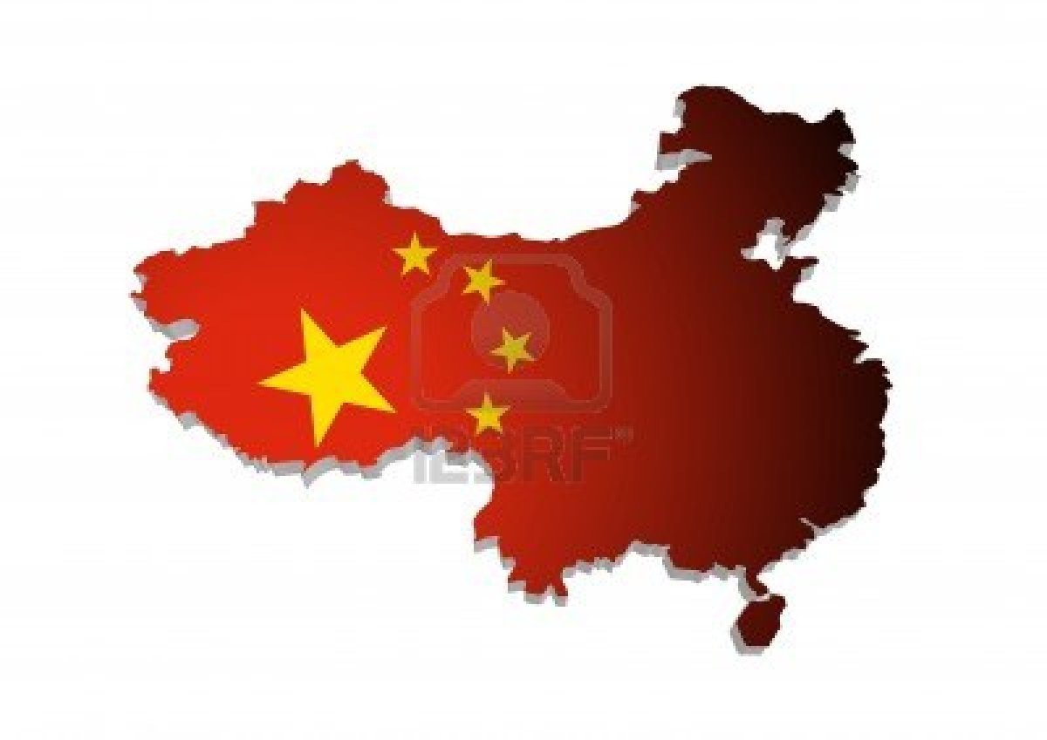
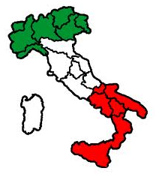
Interoperability and eHealth Italian & Chinese experiences "sharing experience"
Filippo Di Marco
Lapo Bertini

Slide 2
Last but not least ….. the most important issues
IT importance is seldom understood by decision makers in Healthcare sector.
As a result IT for Healthcare market is undervalued
We all need to provide efficient solutions : Interoperability permits several projects collaboration to achieve the result
Providers and Users have to collaborate. (And academics too!)
Succesfull projects allow the market to grow. Good IT means more efficiency and more quality in healthcare which is the real objective for everyone !

Slide 3
Interoperability
Allows exchange of health information within disparate administrative and clinical information systems
a data generated by one system can be accessed and used by another system, independently of technologies
Covers healthcare, clinical information and workflow
Allows management of policy and security
data privacy, confidentiality, individual and organization identifiers…

Slide 4
Interoperability in Europe
Interoperability standards adoption in Europe is making significant progress with the European-level initiatives that are targeted at driving more consistency across the European countries
Each European country is entirely responsible for its healthcare systems, its funding and operation
Health care IT and interoperability within each country is entirely responsibility of the country
Stakeholders at EU level are pushing the EC and Member States to adopt a consistent approach to interoperability
The EC and the USA have started cooperative work on interoperabilty of patient records

Slide 5
Interoperability in Europe
In Europe, the work on eHealth falls within the EC's new "Digital Agenda" which is one of the 5 priority areas identified for development and economic growth in Europe
In 2008 an effort was started to make two services (eSummary and ePrescription) available in another member state, beyond the confines of their own regional or national health system
Interoperability standards chosen were relying mostly on IHE profiles with strong support from industry and IHE Europe
Also, a few extensions and a few constraints to XCA (Cross-Community Access - IHE) and XDR (Cross-enterprise Document Reliable Interchange) have been defined.

Slide 6
Interoperability in Europe
Access ePrescriptions and returned eDispensations
Patient identification (IHE XCPD), patient Consent (IHE-BPPC). access ePrescription (IHE-XCA, plus an IHE-PCC based Prescription CDA document), return eDispensations (IHE-XDR, plus an IHE-PCC based eDispensations CDA document).
Access eSummaries
Patient identifications (IHE XCPD), patient Consent (IHE-BPPC). Access eSummaries (IHE-XCA, plus an IHE-PCC based eSummaries CDA document and IHE-XDS-SD for non coded documents)

Slide 7
Standards: IHE & HL7
IHE is an initiative by healthcare professionals and industry to improve the way computer systems in healthcare share information
promotes the coordinated use of established standards such as DICOM and HL7 to address specific clinical need in support of optimal patient care
Systems developed in accordance with IHE communicate with one another better, are easier to implement, and enable care providers to use information more effectively
Health Level Seven International (HL7) is the global authority on standards for interoperability of health information technology with members in over 55 countries

Slide 8
IHE Advantages
International in scope
Pragmatic, solve real-world problems
Broadest scope of expertise
internationally, with the domains, and the breadth of volunteer and vendor involvement
Open access, “free” resource
Transparent, accessible organization
wealth of information in wiki
Unique testing processes, methodology, tool set
Offerings are comprehensive - “the whole package”

Slide 9
IHE and eHealth in Europe
different aspects: images, lab, reports,…
different organisational and technical solutions
different national and international stakeholders
different regional / national / governmental strategies (if any)
different european initiatives
....trend towards IHE-based approach

Slide 10
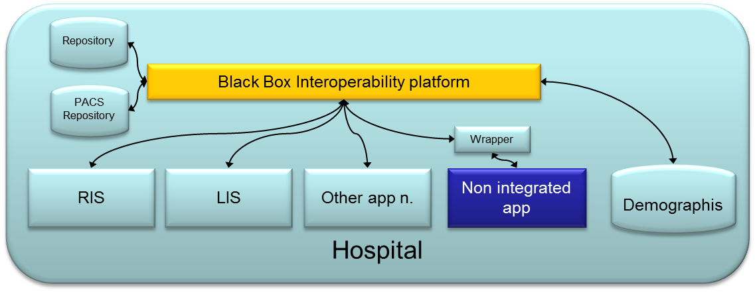
State of the art scenario: hospitals network
Easy and standard way to reports to EHR
Easy and standard data and images sharing GPs exchange information process supported automatically
Easy Integration with non-homogeneous applications
Federated sharing information with other hospitals and other healthcare organization
Demographics data shared in a safe and secure path
Supported:
ePrescription process,
MPI safety sharing,
EHR supply,
PTDA,
Accounting,
Pathology network
Telemedicine
EHR
GP
Federation Sharing
(Registry)

Slide 11
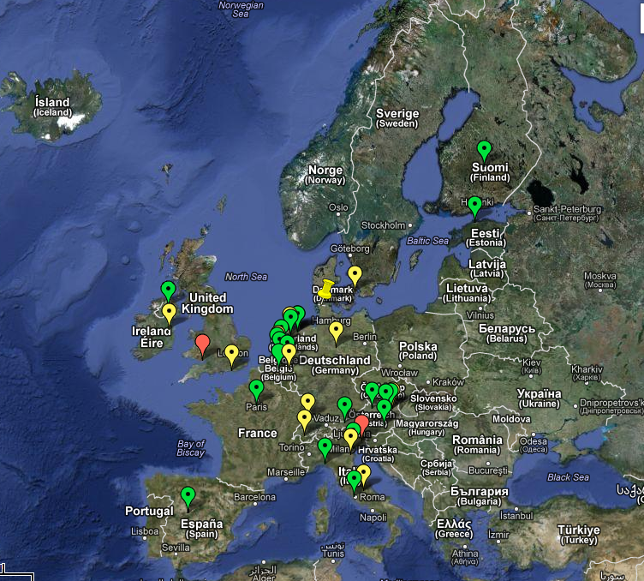
Projects on IHE XDS (registry) in Europe

Slide 12
Italy
Lombardia Region – SISS Project
Emilia Romagna Region – SOLE Project
Veneto Region – DOGE Project
Abruzzo Region – ARIT Project All these are Region-wide eHR & Interoperability between Hospitals, LHAs & GPs
Friuli Venezia Giulia - Region-wide PACS (XDS-I)
Agrigento Province - District Document Sharing (XDS)
Sudtirol - GP Network (XDS/XDS-I)
Abruzzo - Region-wide GP Network (XDS)
Umbria - Region-wide GP Network (XDS)
Veneto - Federated GP Network and ePrescription (XDS/XDS-I/XCA/XDW) - Region-wide
Notes:
Taormina Project
Cardiology Exchange network
Azienda Sanitaria Locale n. 4 Chiavarese
4 Hospitals, 500 physician offices
Italy-Health Optimum
CDA documents, XDS-I, 23 authorities
DOGE
regional project, CDA-documents, clinical data, ePrescription, reports. Practioners – related Hospitals

Slide 13
Italy: a case study
ULSS21 Legnago
Local health (and social) authority located in the Regione Veneto's province of Verona. Regione Veneto
Population: 151.531
4 area-hospitals
Ospedale Generale "Mater Salutis" in Legnago
Ospedale "San Biagio" in Bovolone
Ospedale "Chiarenzi" in Zevio
Centro Sanitario Funzionale in Nogara
Primary care physicians (GPs) are 125
Adopts Doge objectives and technical requirements

Slide 14
Italy: Doge Regional Project
Regione Veneto adopted a long-term eHealth strategic plan that is being implemented through the project Doge implemented through a federated cooperation between system at a district level
Objectives
General Practioners (GP) network Federated model to provide continous interaction between GPs and local health authorities, allowing clinical-administrative information of patients readily available to all the actors involved while guaranteeing the security and confidentiality of the managed information.
Prescription cycle Definition and development of a model allowing the full adoption of ePrescription region-wide.
Technical Requirements
Largely based on IHE ITI eco-system (XDS.b, XCA, PIX/PDQ, NAV, DSUB, XDS-I)

Slide 15
Italy: ULSS21 diagram
Booking
Query and Retrieve
ePrescriptions
Notification
Veneto
Demographics
Services
GP
EMR
Interop
Platform
ePrescription
Patient Summary
Patient Feed
Notification
Query and Retrieve
Reports
Third Party
Repository
Report (CDA2)
Report (CDA2)
Other Departments
Lab

Slide 16
Italy: ULSS21 interoperability functions
Publication and update of the Patient Summary directly from the GP's EMR
Publication of ePrescriptions (medication and services) directly from the GP's EMR
Storage of reports coming from hospital departments and/or service providers (e.g. laboratory)
Notification of the availability of documents to and from concerned actors
Booking of services matching an ePrescription

Slide 17
Interoperability in China
The adoption of RHIS (Regional Healthcare Information System) and (CRCHS) Cross-Regional Collaborative Health is defined as the backbone of new (Chinese) healthcare reform as well as the future China Healthcare infrastructure.
Since 2009, the government of PRC decided the strategy and published many policies to encourage, to develop and to deploy RHIS and CRCHS
eHealth adoption has become a hot topic for officers, healthcare providers, healthcare professionals, vendors, and related organizations

Slide 18
China
Barriers to wide-spread adoption come from the variety and disparity of existing systems in hospitals, clinics and health bureau
International and national standards are being considered to address interoperability
IHE is well developed by so many vendors and developed such a workable system and, especially, provides Connectathon testing.
PRC government is investing a lot, and involving many functions, including MOH, MIIT (Ministry of Industry and Information Technology), SFDA, Standard Committee, National Standard Research Academy, etc.

Slide 19
China: a case study
Daqing Municipality HIE Project
Initially conceived in October 2010
Awarded in 2012
Timing: 3 years project – Cost: 5 Mio $
Target: construction of municipal-level health information platform to strengthen the public health, medical services, new rural cooperative information exchange, and integrated application management
By means of: use of harmonized technical standards in order to facilitate interoperability between each part of the city's medical and health information system

Slide 20
Daqing Project: fact sheet
Daqing: prefecture-level city in Heliojiang Province
Population: 2.200.000
10 Health Bureau, 6 Municipal Hospitals, 1 District Hospital, More than 800 communities
Documents managed for each year
1.200.000 for inpatients
3.500.000 for outpatients
Type of documents managed
prescriptions for cure
prescription for drugs
reports with lab results
CT and ultrasound reports and images
all generic reports by HIS

Slide 21
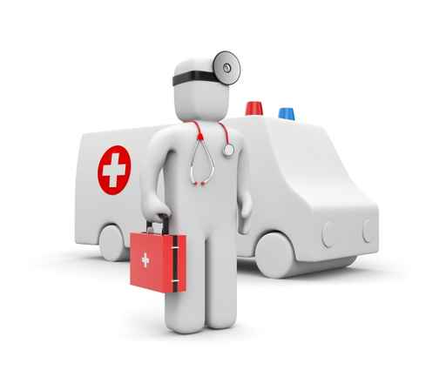
Daqing Project: Actors
Set standards, unify data
Hospital performance assessment
Hospital management and medical practice supervision
Unified procurment and prices
Unified distribution
EMR data for analysis and research
Remote consulting with telemedicine
Health
Bureau
Medical
Research
Entities
supplier
Health insurance policies and performance assessment criteria set with health bureau
Find out illegal healthcare insurance program
Essential drugs with zero price difference
Drug storehouse management
Clinical pathway to regulate action
Build up performance assessment system
Hospital
Health
Insurance
Entities
Reduce repeated examination and patients’ expenses
Reduce drug expense
Enforce the supervision measurements,
Reduce phenomenon of one card used by whole family
Improve the community service quality
Improve the customers satisfaction
The performance assessment set the customer satisfaction as the main criteria
Through the implementation of clinical pathways reduce the repeated examination and unnecessary prescription
Performance assessment to improve doctors’ motivation
Patients
Doctors

Slide 22
Daqing Project in a glance
One card: for Id through whole region
One network: dedicated health information network
One center: municipal health data center
One platform: data sharing and exchanging platform
Five services: primary care, citizen care, healthcare management, healthcare collaboration
12 application systems
community healthcare system, EMR-based HIS, citizen’s health card system, two-way referral, telemedicine, citizen healthcare web portal, administrative decision analysis system, KPI system, healthcare administrative management system, OA system, health insurance interface system, intergrated public health system

Slide 23
The architecture: overview
Interop
Platform
Web Portal
MPI
Apps
Interfaces
Citizen
Health Bureau
Physicians, nurses
Two-way referrals
Business intelligence
KPI
IHE XDS
HL7/DICOM
Adapters
Patient Demographics
Coding

Slide 24
Functions
Health data center and data integrated platform
Unified Patient / Citizen ID identification
Health archive query system for healthcare provider
EHR Viewer
Citizen’s health web portal
Two-way referral system (a two-way relationship between a primary health care provider or facility and a higher-level hospital or facility during the transfer and discharge of a patient.)
Decision analysis, KPI, Adminstrative auditing
Virtual sub-healthcare authorities

Slide 25
Conclusions
Interoperability is today the chosen “tool” to promote and support cooperation between the diverse caregivers
Within the hospital, among hospitals and between hospitals networks
Between hospital and primary care (GPs)
Between institutions and other healthcare providers
At regional or national level as a building block of a federated PHR
Interoperability can
…support the current and future stage of healthcare systems consolidation and development
…provide a flexible cooperation system that can be adapted to each single healthcare setting
…introduce a method for document sharing and for the management of clinical, healthcare and administrative processes
…drive gains in efficiency towards financial cost effectiveness

Slide 26
Basic Needs for Interoperability
1 – Common Identification: i.e. Unique ID for each person
2 – Common Dictionaries: i.e. A Code for each Diagnose / Procedure / Service / Facility
3 – Common Language:
e.g. HL7 = how to exchange messages
4 – Common Rules e.g. IHE profiles

Slide 27
Role of each Stakeholder: the Italian experience
Government National Level Objectives; Strategic Information needs
National Institutions (ISS, CNR) Guidelines; Information Data Flow rules and standards
Government @ Provincial Level Resources (€, ITC, Human), Information Data Flow rules
Academic institutions – Universities Guidelines, IHE certification, Dictionaries specifications
Public Users (Hospital, LHA) &
Private Users (GPs, Specialty Doctors, Hospitals) Specific needs, Economic & human resources
Healthcare Device Providers Device compatible with standards
Software Providers Standard and Data flow – compatible Software products

Slide 28
Conclusions
In December 2012, WHO held in Geneva a Forum Interoperability and Standards open to all members of WHO
Consensus on the floor from participating members (countries) established interoperability as the essential brick to eHealth
It also emerged that interoperability without adoption of international standards (such HL7 and IHE) and methodology cannot succeed and should be discouraged
WHO will issue a recommendation to its members on interoperability to address this
Standards for interoperability are now in a mature stage. No more excuses or reluctancy. Interoperability is practical.

Slide 29
Filippo Di Marco
Thank you for your attention
Life flows through
our software
filippo.dimarco@dedalus.eu
life flows in our software

Slide 30
