Slide 1
Assessing the development of the South African eHealth Strategy against the recommendations of the WHO/ITU eHealth Strategy Toolkit
Dr Rosemary Foster
MRC/NMMU

Slide 2
Use of the word “strategy”
The art of planning and directing high-level military operations and movements in a war or battle.
A high-level plan to achieve one or more goals within the context of given constraints.

Slide 4
Use of the word “strategy”
Now used in all spheres of life including eHealth
For eHealth, broadly used in two ways:
a high level plan, e.g. Scottish eHealth Strategy (2011-2017)
a hybrid - high level plan combined with a framework for implementation, e.g. Australian eHealth Strategy (2008) included a detailed eHealth architecture model

Slide 5
WHO/ITU National eHealth Strategy Toolkit
Published in 2012
Aims to provide practical guide for governments, relevant ministries and departments for:
Establishing a national eHealth vision
Developing a national eHealth action plan
Developing a monitoring and evaluation plan
NB: Toolkit does not guide the creation of a separate document called an “eHealth strategy”

Slide 6
Use of the word “vision”
Textbook methodologies for strategy development
Vision statement – where you want to be?
Mission statement – how are you going to get there?
“Vision” in the Toolkit addresses:
Why does country need a national approach to eHealth?
What will national eHealth plan achieve?
What components are required to achieve desired outcomes?
“Vision” (Toolkit) = High-level plan or strategy for eHealth

Slide 8
Work on South African eHealth Strategy
Country had no previous strategy
Several earlier drafts
White paper on eHealth
Fresh start in late 2011
When the Toolkit was published in 2012 the eHealth Strategy for South Africa was already at the stage where endorsement was being sought
To what extent did the processes followed in the development of the South African eHealth Strategy conform to the recommendations provided in the Toolkit?

Slide 9
Toolkit guidelines – nine steps
1. Managing the process
Clear plan
Well-defined governance mechanisms for consultation, communication and approvals
Core team with sufficient technical knowledge, analytical ability and communication skills
2. Engaging with stakeholders
Involve range of multisectoral stakeholders to gain perspectives on expectations for eHealth
Engagement continued throughout strategy development process
3. Establishing strategic context
Establish context early
Identify the goals and challenges of the health system that eHealth can help to address
Take into account broader social and development goals

Slide 10
Establishing the context

Slide 11
Toolkit guidelines – nine steps
4. Learning from trends and experience
Research eHealth successes and failures of other countries
Understand trends and best practice
Identify available technologies and potential outcomes
Identify challenges and risks that should be taken into account
5. Drafting initial strategy
Draft an “unconstrained” strategy that expresses an ideal national eHealth environment
Identify opportunities that can be pursued in future
Determine degree of change required in order to develop the ideal eHealth environment
6. Identifying required components
Building blocks required to deliver on the goals of the strategy
Toolkit lists seven components that should be addressed

Slide 12
Learning from trends and experience

Slide 13
Toolkit guidelines – nine steps
7. Gathering information on eHealth environment
Determine which building blocks exist, can be re-used or expanded
8. Assessing opportunities and gaps
Describe gaps between what is required and what already exists
Identify opportunities for re-use or sharing
Address gaps
Identify risks and barriers
Refining strategy and develop recommendations
9. Refine strategy based on the outputs of steps 6, 7 and 8.
Develop set of recommendations on which to base the action plan
Obtain endorsement of the strategy
Communicate strategy to the broader stakeholder community

Slide 14
Gathering information on the environment

Slide 15
Method
For each of nine steps recommended by the Toolkit
Compare the activities and outputs recommended to the processes followed in the development of South African eHealth Strategy
Rate elements within each step from 0 to 2:
0 - “Was not done”
1 - “Was partially done”
2 - “Was done”

Slide 17
Results: 1. Managing the process
Elements | Rating
High-level health sector leadership and support | 1 | On-going support of NHISSA NHISSA kept leadership updated NHISSA only meets quarterly
Appropriate governance structure and mechanisms | 1 | No formalized governance structure Regular progress reports to NHISSA Input from eHealth subject matter experts
Multi-disciplinary project team with requisite skills and expertise | 1 | Not project-based Small but capable core team
Agreed timeline and resources for completing the work | 0 | No project plan No agreed timelines No budget or other resources assigned

Slide 18
Results: 2. Engaging with Stakeholders
Elements | Rating
Clarify the role of government in national eHealth development | 2 | Strategy development directed by government Scope limited to public-sector
Identify stakeholder groups that need to be involved | 1 | Did not include a broad stakeholder group Input solicited from relevant public sector stakeholders on NHISSA committee Input solicited from senior managers in the National Department of Health.
Develop approach to managing these groups | 0 | No specific approach was developed.
Define and communicate points of consultation | 0 | No specific consultation points were defined.

Slide 19
Results: 3. Establishing Strategic context
Elements | Rating
Research population health and demographics | 1 | Partially done. Section 5: eHealth’s contribution to NDoH’s strategic aims.
Describe the health system | 1 | Partially done. Touched on throughout the document.
Review national health strategy, goals and priorities | 2 | Reviewed NSDA 2010-2014 Reviewed 10 Point Plan 2009-2014
Identify economic and social developments goals relevant to health | 0 | Only takes into account health context
Identify work already done on strategies for eHealth, ICT and HIS | 2 | Examined previous attempts to develop strategy Took in account NHC/MIS (1994)
Identify the strategic goals and challenges most directly affected by the eHealth vision | 2 | Identified opportunities where eHealth can enable and support interventions planned in: NSDA 2010-2014 10 Point Plan 2009-2014
Describe how a national eHealth environment can support these goals and challenges | 2 | Described how eHealth could enable and support service delivery interventions

Slide 20
Results: 4. Learning from trends & experience
Elements | Rating
Research national eHealth visions, strategies and programmes | 2 | Researched other country eHealth strategies and programmes
Research international eHealth trends, best practices and outcomes | 2 | Researched eHealth trends, best practices and outcomes in other countries

Slide 21
Results: 5. Draft initial vision (strategy)
Elements | Rating
Agree time horizon for the eHealth strategy | 2 | Target delivery dates included
Define desired eHealth outcomes based on health goals and challenges | 2 | Desired eHealth outcomes defined within SA context
Describe rationale for each outcome sought; link outcomes to the strategic context | 2 | Desired eHealth outcomes linked to health system goals
Develop an initial vision statement | 2 | Initial vision statement articulated
Describe what delivering the national eHealth vision will mean for the stakeholders | 1 | Partially done Section 5.3: Leveraging eHealth to support NDoH’s strategic aims
Develop one or more scenarios that put eHealth vision in practice | 2 | Scenarios where eHealth could enable and support service delivery interventions of the NSDA and the 10 Point Plan identified and described

Slide 22
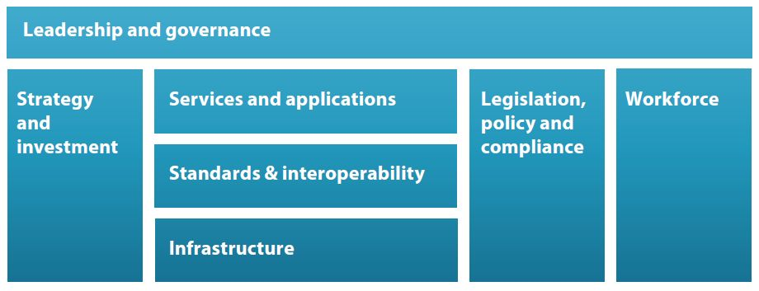
Seven building blocks

Slide 23
Results: 6. Identify required components
Elements | Rating
Leadership and governance | 2 | Strategic Priority 1: Strategy and Leadership. Strategic Priority 4: Governance and Regulation.
Strategy and investment | 2 | Strategic Priority 1: Strategy and Leadership. Strategic Priority 4: Investment, Affordability and Sustainability.
Services and applications | 2 | Strategic Priority 8: eHealth Foundations. Strategic Priority 9: Applications and Tools to support Healthcare Delivery.
Infrastructure | 2 | Strategic Priority 8: eHealth Foundations.
Standards and interoperability | 2 | Strategic Priority 3: Standards and Interoperability.
Legislation, policy and compliance | 2 | Strategic Priority 4: Governance and Regulation.
Workforce | 2 | Strategic Priority 7: Capacity and Workforce.

Slide 24
Results: 7. Gather information on eHealth environment
Elements | Rating
Leadership and governance | 2 | Section 4.1: Structural, Policy and Legislative Context. Strategic Priority 1: Strategy and Leadership. Strategic Priority 4: Governance and Regulation.
Strategy and investment | 2 | Section 4.2: The requirement for a National eHealth Strategy Section 4.3: eHealth funding and expenditure. Strategic Priority 1: Strategy and Leadership. Strategic Priority 4: Investment, Affordability and Sustainability.
Services and applications | 2 | Section 4.6: Telemedicine Section 4.7: mHealth Section 4.14: Notable current initiatives in eHealth Strategic Priority 8: eHealth Foundations Strategic Priority 9: Applications and Tools to support Healthcare Delivery
Infrastructure | 2 | Section 4.4: eHealth Maturity Section 4.5: NHC/MIS Section 4.3: eHealth funding and expenditure Strategic Priority 8: eHealth Foundations
Standards and interoperability | 2 | Section 4.8: eHealth Standards Strategic Priority 3: Standards and Interoperability.
Legislation, policy and compliance | 2 | Section 4.9: Policies and Regulations affecting eHealth Strategic Priority 4: Governance and Regulation.
Workforce | 2 | Section 4.11: eHealth Capacity Building Section 4.10: eHealth Associations and Conferences Strategic Priority 7: Capacity and Workforce.

Slide 25
Results: 8. Assess opportunities and gaps
Elements | Rating
Leadership and governance | 2 | Strategic Priority 1: Strategy and Leadership. Strategic Priority 4: Governance and Regulation.
Strategy and investment | 2 | Strategic Priority 1: Strategy and Leadership. Strategic Priority 4: Investment, Affordability and Sustainability.
Services and applications | 2 | Strategic Priority 8: eHealth Foundations. Strategic Priority 9: Applications and Tools to support Healthcare Delivery.
Infrastructure | 2 | Strategic Priority 8: eHealth Foundations.
Standards and interoperability | 2 | Strategic Priority 3: Standards and Interoperability.
Legislation, policy and compliance | 2 | Strategic Priority 4: Governance and Regulation.
Workforce | 2 | Strategic Priority 7: Capacity and Workforce.

Slide 26
Results: 9. Refine strategy and develop recommendations
Elements | Rating
Adjust scope and focus | 2 | Opportunities sorted into three groups: Build on what exists Needs significant procurement and implementation Needs further planning
Refine initial vision | 2 | Refined - what is achievable in the short, medium and long term. Ten strategic priority areas were identified
Develop recommendations | 2 | Recommendations grouped within ten priority areas Key activities with clear outputs and target dates identified.
Gain endorsement and publish eHealth strategy | 2 | Presented to the National Health Council Signed by the Minister of Health and the Director General of the Department of Health

Slide 27
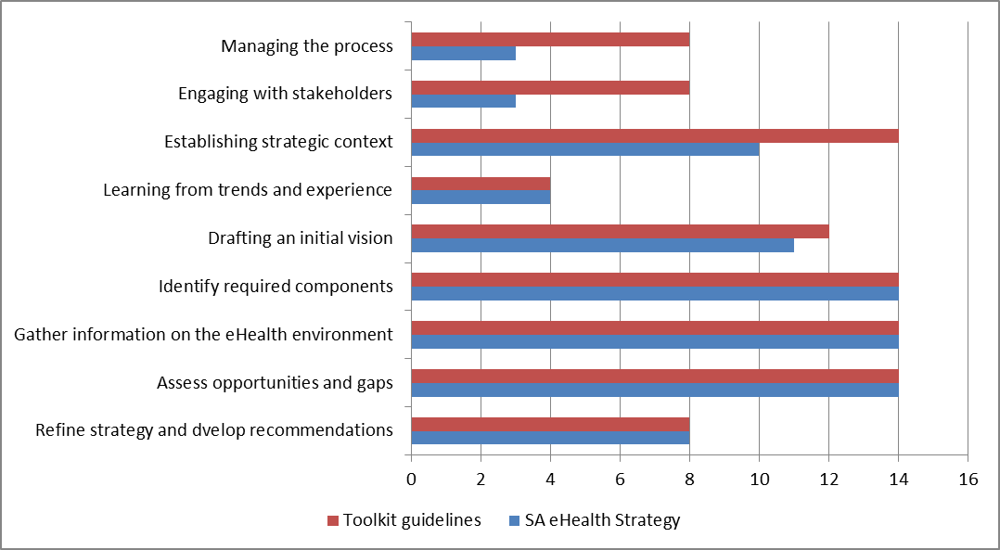
Discussion

Slide 28
Conclusion
Semantics
Weaknesses
Stakeholder inclusion
Management of process
Establishing strategic context
Difficult to assess quality of data gathering
SA eHealth Strategy is a hybrid
Toolkit and Enterprise Architecture work

Slide 31
