Slide 1
Service design as an approach for envisioning e-health solutions
Izak van Zyl, Terhi Pennanen
Cape Peninsula University of Technology
Laurea University of Applied Sciences
---
Port Elizabeth
July 2013

Slide 2
The paper contains…

Slide 3
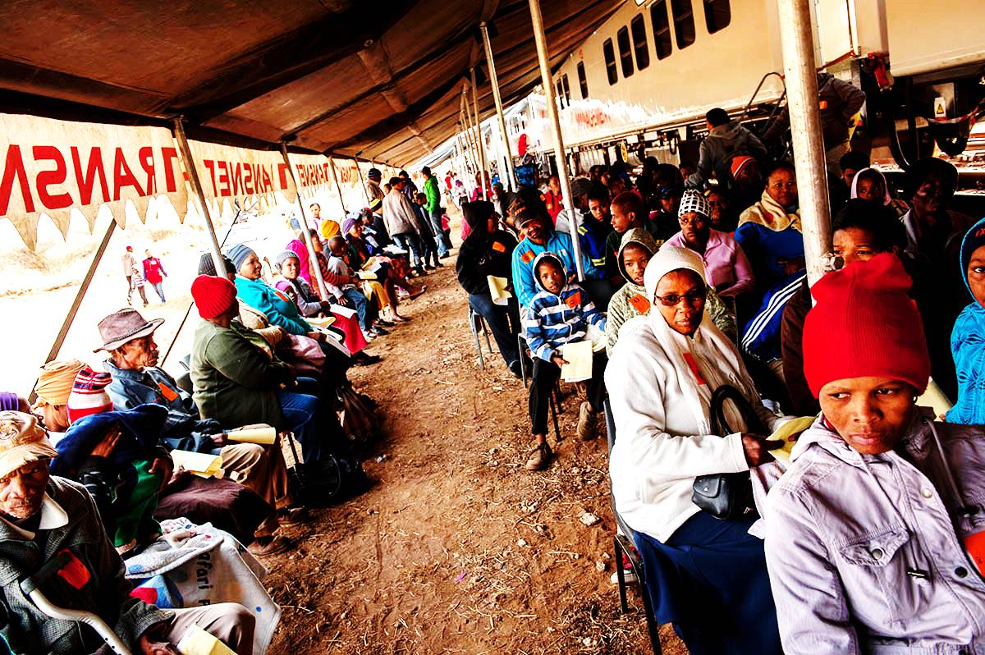
Challenges and expectations facing the local health sector
Phelophepa Health Train, Eastern Cape

Slide 5
Transformative capacities of e-health

Slide 6
Instead of preaching to the choir…

Slide 7
The problem of adoption

Slide 8
Readiness and maturity
Lack of uniformity: ‘national template for health reform’
Lack of standardisation between health information systems

Slide 9
South Africa in the techno landscape
WEF Global Information Technology Report 2013

Slide 10
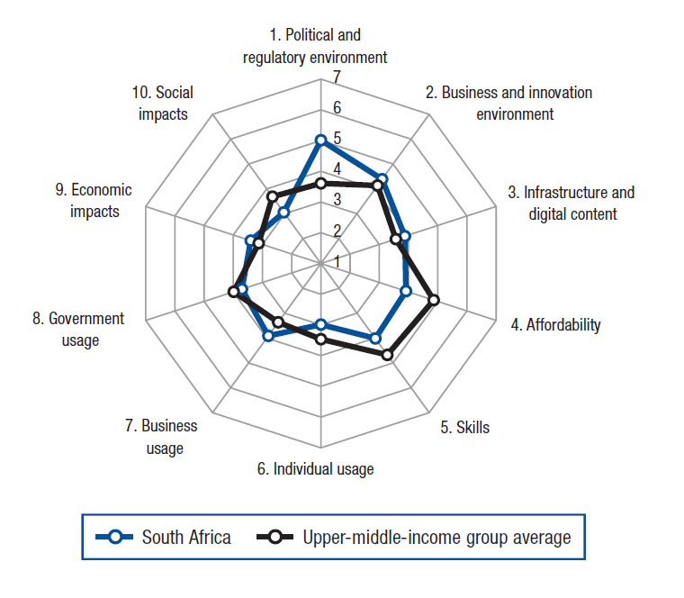

Slide 11
Highly differential allocation of ‘patients to physician’ in rural and urban settings
Lack of ICT infrastructure and resources
Patient identification
Issues of culture, social interaction, meaning and symbolism

Slide 12
User participation in e-health development

Slide 13
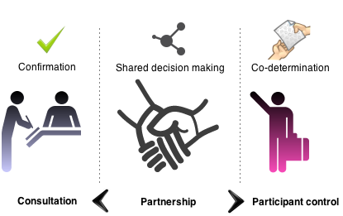
Theory of participation

Slide 14
Limited user participation in and knowledge about e-health solutions
Limited interaction with interventions among health workers, patients, and medical staff
A knowledge divide between novice or disinterested users, and involved or expert stakeholders

Slide 15
Envisioning a participatory approach
Health challenges
Potential of e-health
?
Problem of adoption

Slide 16
Envisioning a participatory approach
Health challenges
Potential of e-health
?
Problem of adoption
Integrated, human-focused approach

Slide 17
Service design
Key principles:
The iterative, human-centred design of innovative services for <…>

Slide 18
Service design
Key principles:
User-centric; complex context; participatory; collaborative design; process focused; systemic integration; goal-driven; …

Slide 19
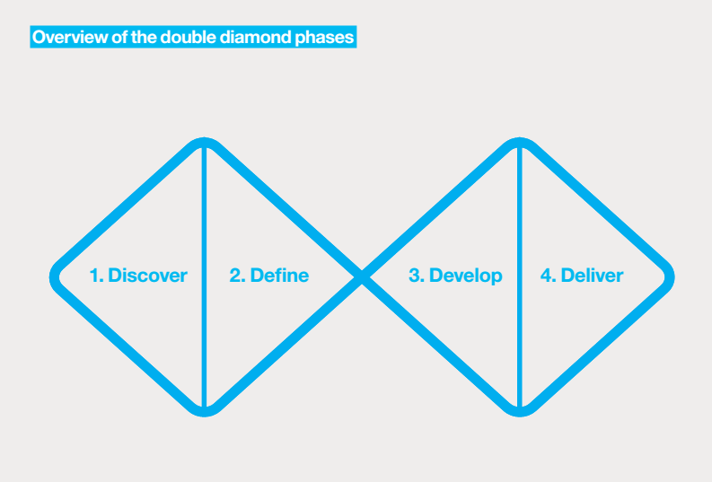
Process focused
Mäger’s four-phase process

Slide 20
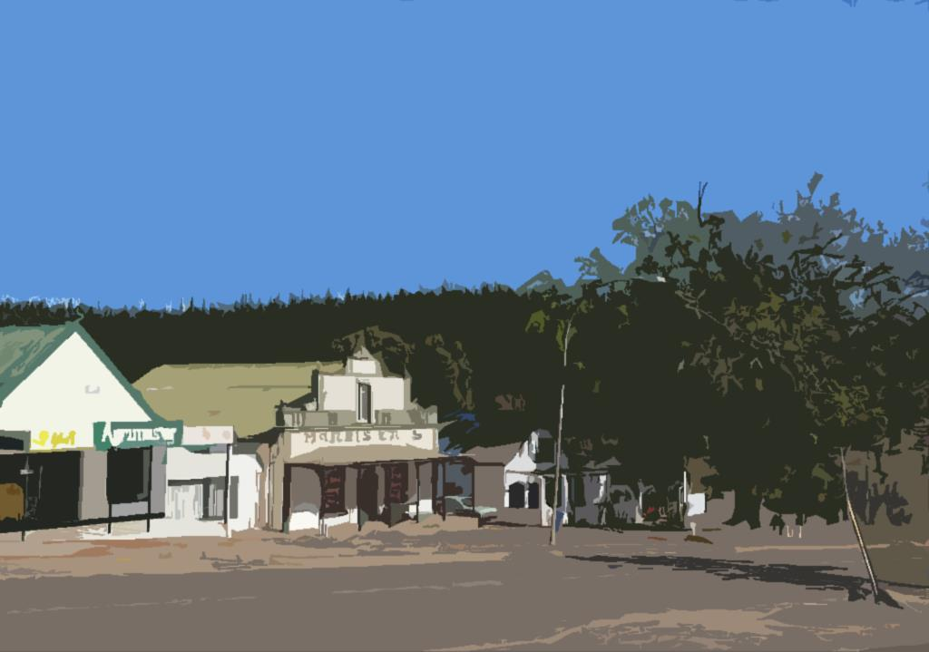
Our ‘local’: where we work

Slide 21
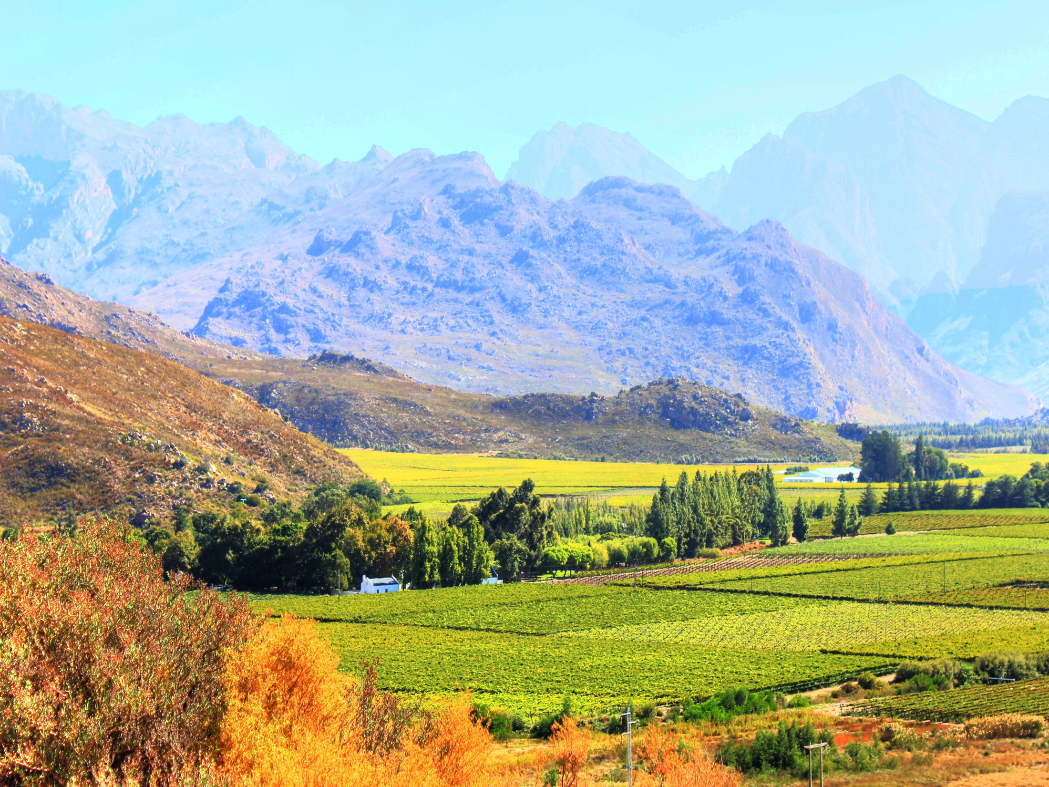

Slide 22
Grabouw
Semi rural town approx. 65 km from Cape Town
Located in the Elgin Valley
Agricultural service centre
Two-thirds of South Africa’s export apples

Slide 23
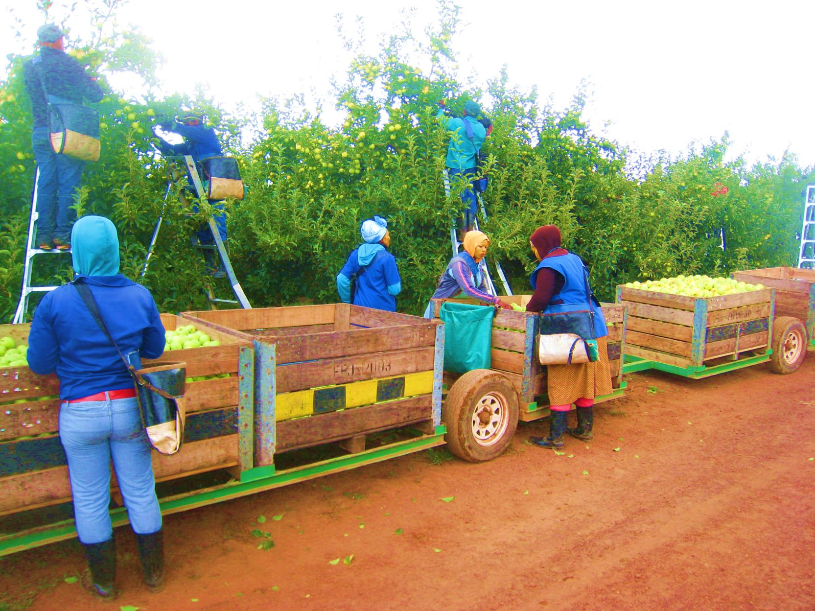
Apple Town | The Big Apple

Slide 24
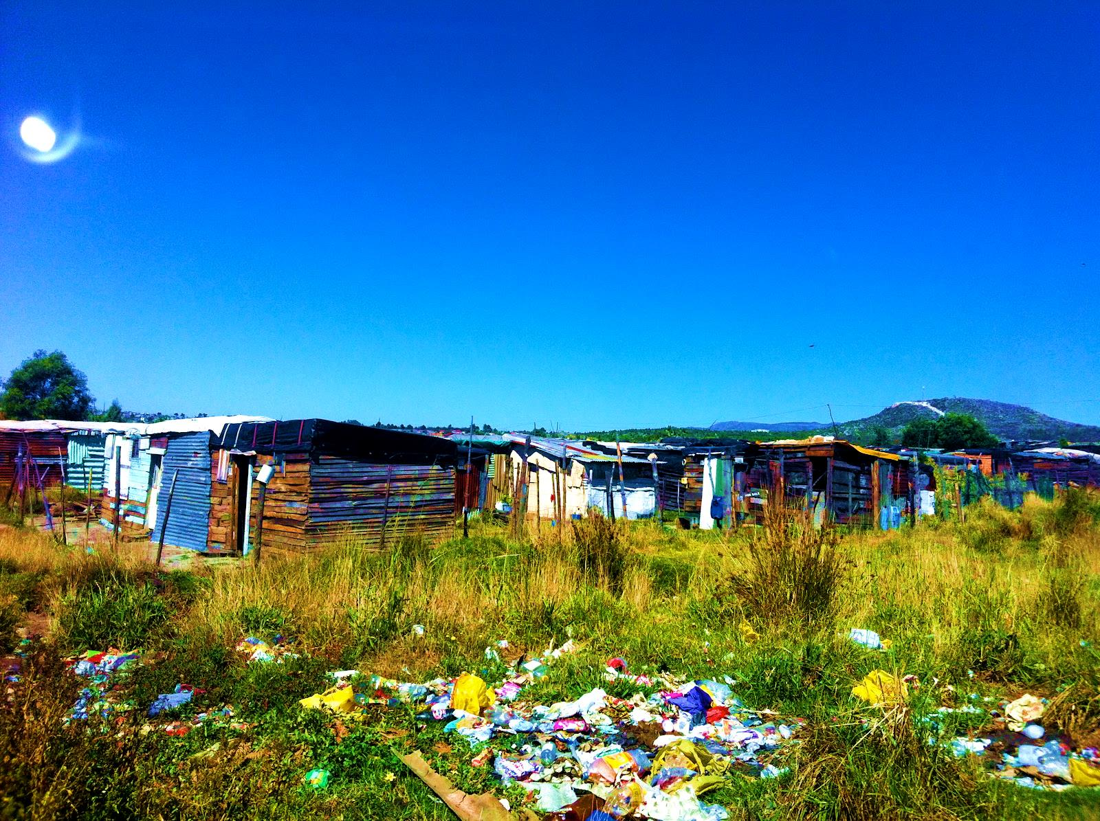

Slide 25
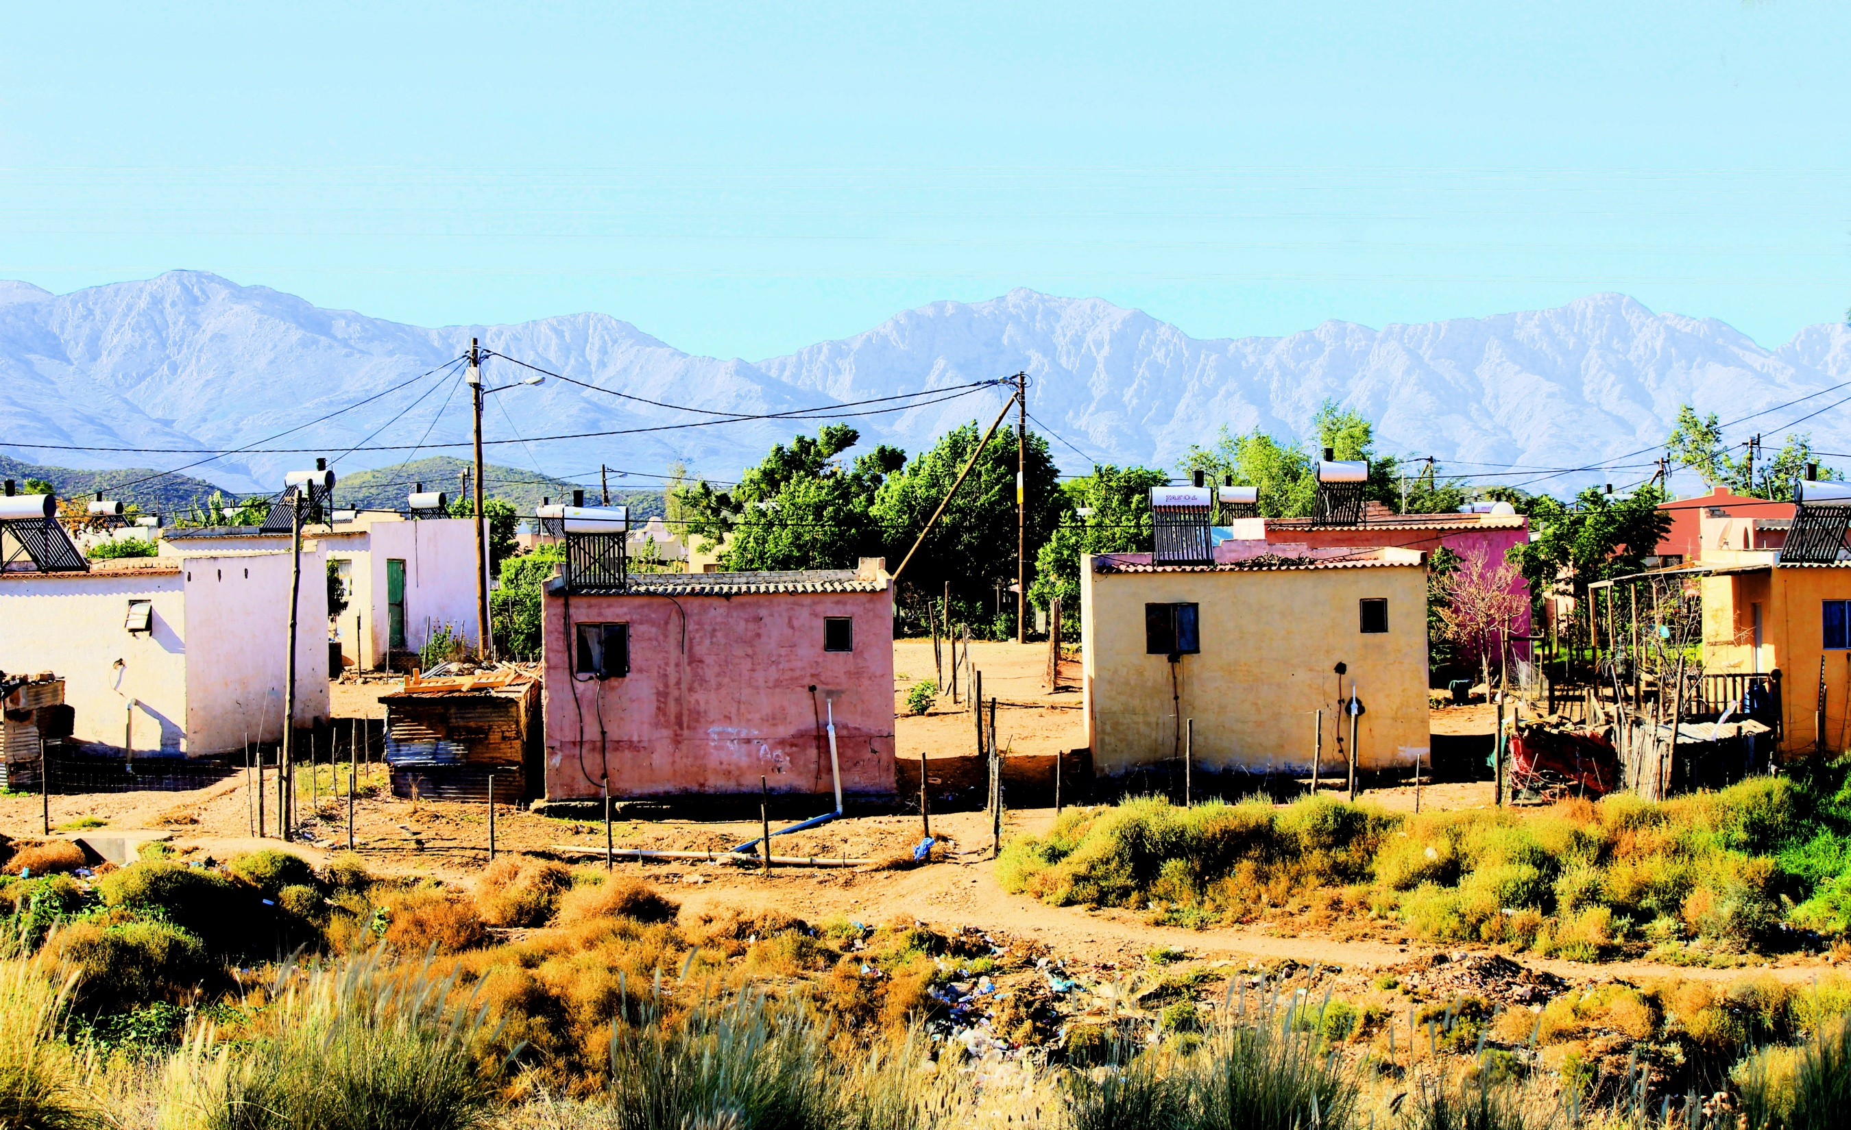

Slide 27
Two intermediate actions
(1) Exploration and insight: defining goals for development and a framework for collaboration

Slide 28
Two intermediate actions
(2) Context and stakeholder mapping: a tool to build shared understanding

Slide 30
Grabouw Enablement Forum
Stellenbosch (CENCE)
Grabouw (ELF, Entrepreneurship Forum, Youth Centre, Day Hospital)
CPUT, UWC

Slide 31
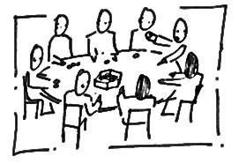
Reflections on a context mapping exercise
A pilot workshop with representatives from Grabouw, Stellenbosch, and Cape Town
The goal was to “discover Grabouw”
Share thoughts and viewpoints and reach shared understanding of the current situation
No “wrong or right” views
Discussion of outcomes

Slide 32
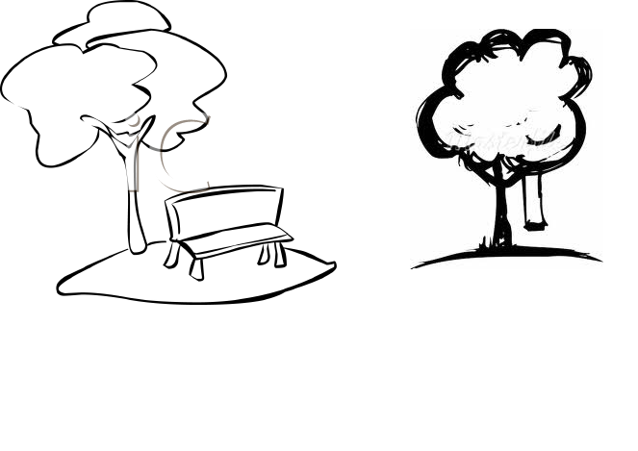
Part 1. Map
Please discuss in your group, and add on the map the cards of:
Important places (formal and informal)
Organizations/people
Services
You can also add a name, description, comments etc. to the cards - or add new ones on plank papers
The exact placement of the cards is not crucial – focus on discussion

Slide 34
If you look at your maps, how are the following groups represented?
Youth
Agriculture: farmers and farm workers
Education and training
Health
Information and communication
Local economy and business
* Please also discuss the relationships and interactions between these groups

Slide 35
Part 2. Describe
Please describe with post-its:
Strengths of the community (yellow)
Problems and challenges (orange)
Hidden assets (green)
General community spirit (pink)
You can write or draw: what ever is best for you

Slide 36
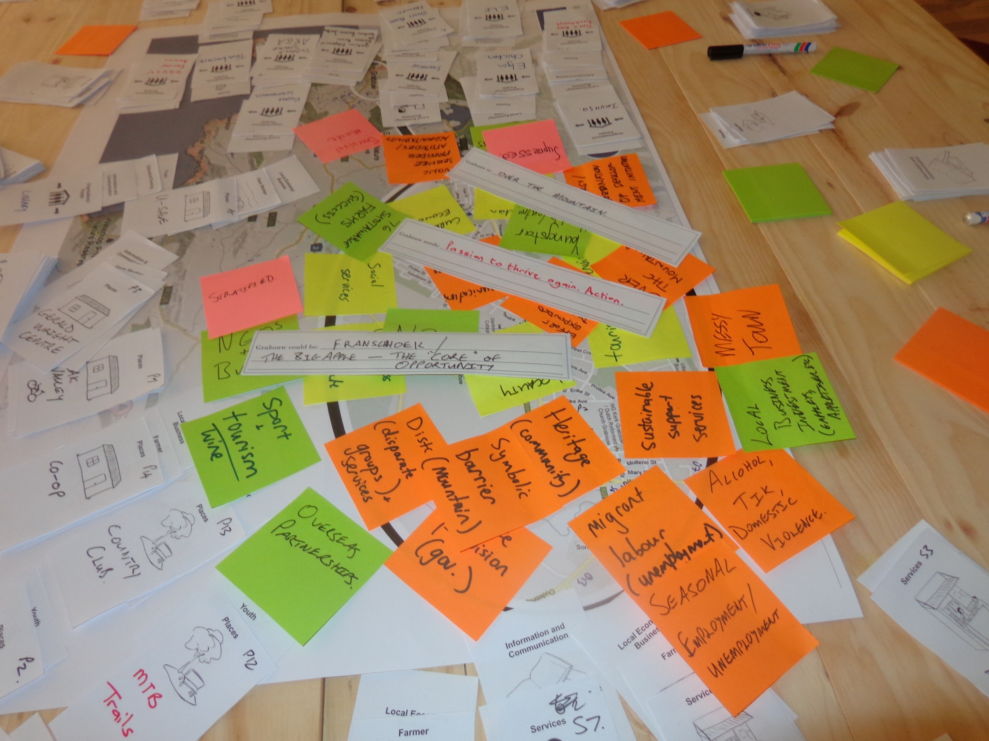

Slide 37
Part 3. Aim
Please complete:
Grabouw is...
Grabouw needs...
Grabouw could be...

Slide 38
Part 4. Discuss, reflect
In your group, please reflect on the ‘findings’ and discuss any significant outcomes

Slide 39
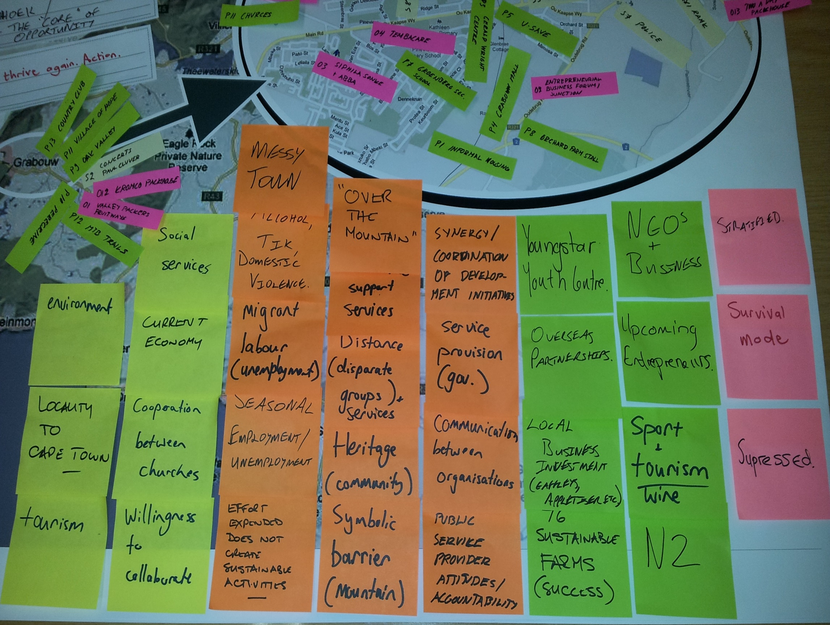

Slide 40
Health organisations, services
Fruit pack houses in the Valley
Farms with in-house clinic and education services
Grabouw Community Clinic (Day Hospital)
Home- and community-based services: Thembacare Hospice, ELF, Siphila Sonke, ABBA

Slide 41
Strengths
Stable, thriving local economy
NGOs are visibly effective
Local churches
The natural environment and sport tourism
A general willingness to cooperate

Slide 42
Challenges
Lack of communication and coordination
Perceivable distance
Service provision is slow, ineffective, non-sustainable (not limited to health)
Migrant labour/seasonal employment: variable unemployment and vagrancy

Slide 43
Challenges
Accountability on part of the local government
Crime, violence, substance abuse
Mountain as symbolic barrier

Slide 44
Hidden assets
Youngstar Youth Centre
Leveraging on overseas partnerships: credibility to local development
Business investment and entrepreneurship – the nucleus of the local economy

Slide 45
Hidden assets
76 farms: food security and employment
NGOs
Sport and wine tourism
The national highway (N2) as a regional gateway or nexus

Slide 46
Community spirit
Suppressed
Stratified
Survival mode

Slide 47
Community spirit
Grabouw is… “over the mountain”
Grabouw could be… “Franschhoek. The ‘big apple’. The ‘core’ of opportunity”
Grabouw needs… “Passion to thrive again. Action.”

Slide 48
Reflections
How do these findings build toward a framework of e-health?
How did we approach and engage persons and organisations in Grabouw?
How can we ensure adequate representation? What is adequate?

Slide 49
Thank you!
Ground-breaking questions?

