Slide 1
Engaging with the private sector

Slide 2
Engaging with the private sector

Slide 3
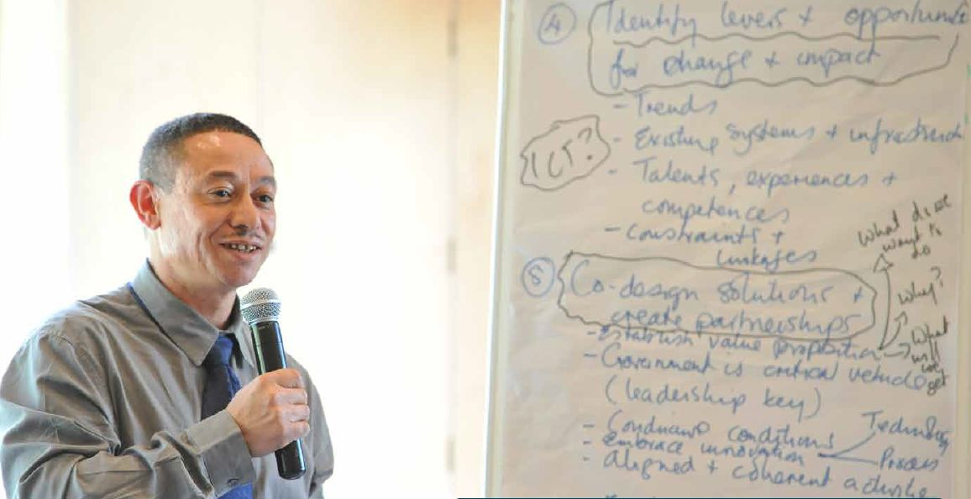

Slide 4
Engaging with the private sector
Complex health challenges faced nationally and regionally.
Unlikely to be resolved by a single solution, or by stakeholders acting in isolation.
Partnerships which mobilise our collective talents and resources are key to responding to these health challenges effectively.
For partnerships to be become effective they will need to be underpinned by strong leadership and relationships being established based on trust.

Slide 5
Purpose
To establish such a framework and define the next steps required to strengthen engagement between stakeholders.

Slide 7
