Slide 1
Telemedicine as an effort to address data communication challenges between primary and secondary health institutions In Namibia: a Pilot study.
Meke Shivute , University of Cape Town
HISA Conference, NMMU,Port Elizabeth
3rd - 5th July, 2013

Slide 2
Outline
Background
Data communication Challenges
Integrated Health Care Information Management System (IHCIMS)
Preliminary results
Future research

Slide 3
Background
The Namibian healthcare system is strongly influenced and inherits its system from the South African Healthcare System.
Decetralised
Current system has undergone major reforms.

Slide 4
Background
Decetralised model of healthcare delivery.
Enhance efficiency
Improve the quality of services offered
Devolving authority to the 13 MOHSS regional directorates.
A number of health systems have been deployed.

Slide 5
Background
Over 61 Systems running in MOHSS
Integrated Health Care Information Management System (IHCIMS)
Directorate for Special Programs
HIVQUAL HIV and AIDS databases
Electronic Patient management system (EPMS)
National Institute Pathology
MEDITECH
Therapeutic Information and Pharmacovigilance Centre (TIPC)
Adverse Medicine Reactions (AMR)
Vigiflow, and the
Therapeutic Information DataBase (TIDB)

Slide 6
Background
National referral hospital (1)
Intermediate Hospitals :3 (Public)
District Hospitals (30 public : 9 Private)
Health Centers (44 public , 8 Private
Clinics (265 public, 75 private)
Outresearch services /Mobile clinics no physical health facilities (1150)
Public health services provided through the District hospitals, Health centers, and Clinics.
Intermediate hospitals and one national referral hospital support the district hospitals.

Slide 7
Data communication Challenges
Processes and systems are not harmonized
Underreporting from Primary health care facilities leads to unreliable statistical data on disease-specific treatment burdens
Inadequate information/indicators coverage by primary systems and lack of coordination between operational institutional systems and processes.
Limited and poor access to health services (physical facilities and outreach services)
impacted negatively on healthcare service delivery especially for the underserved communities and clients.

Slide 8
IHCIMS
Integrated Health Care Information Management System (IHCIMS).
Hospital management system by Navayuga infotech (Launched in 2011)
Piloted in two hospitals
22 Modules of which () implemented
To be extended to 34 state hospitals by 2014
Functions
Automate daily operations – services rendered to Patients
Electronic medical information

Slide 9
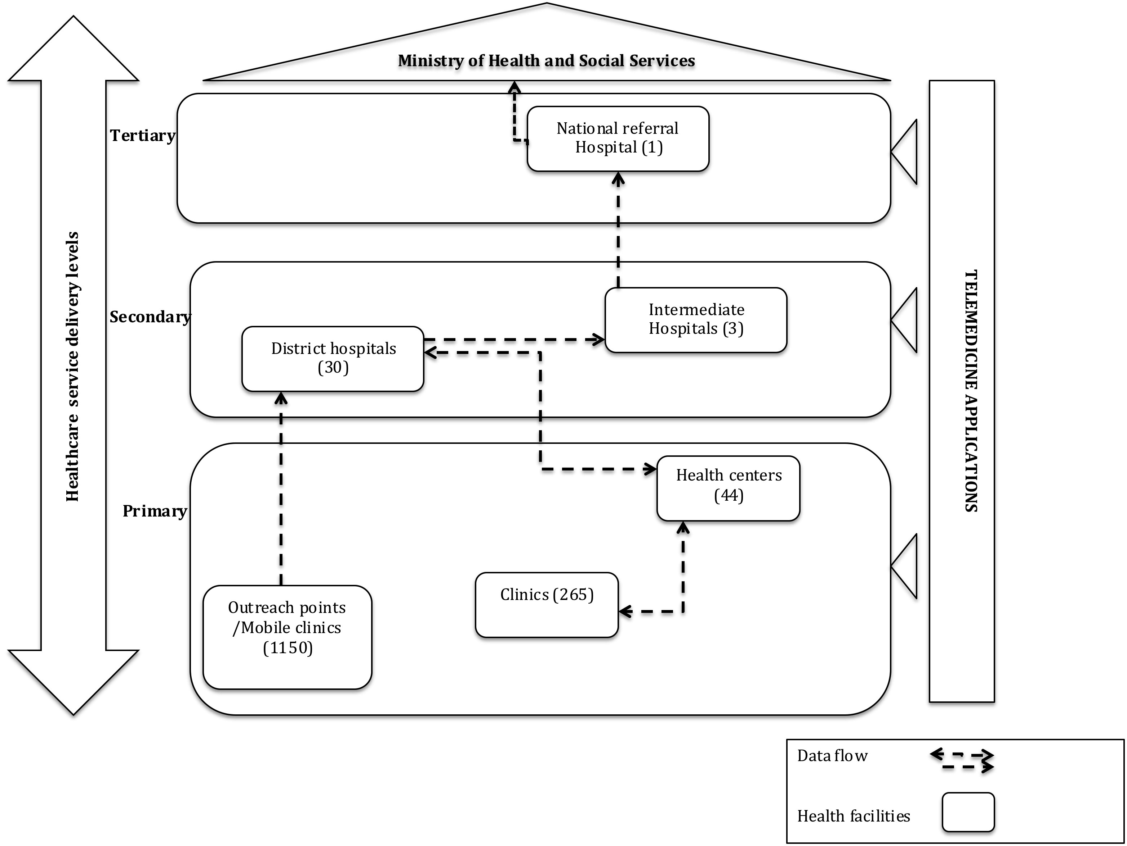
Preliminary results

Slide 10
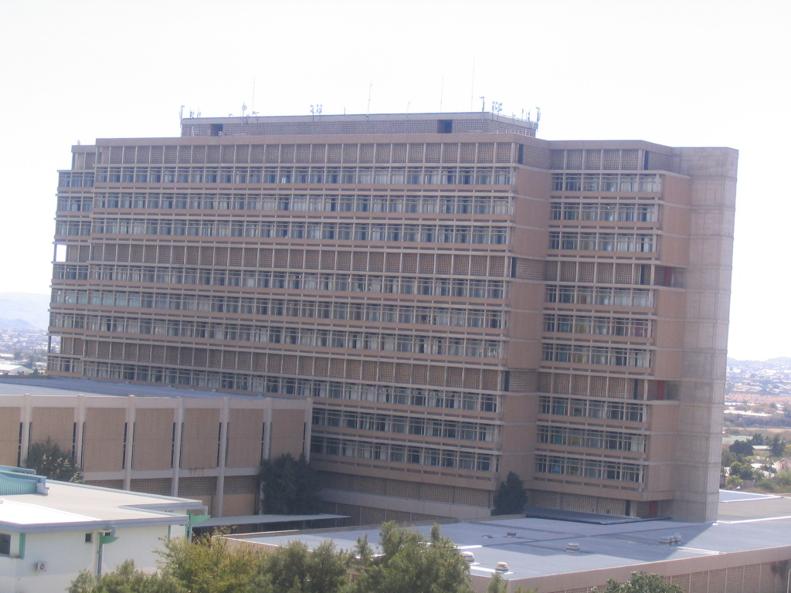
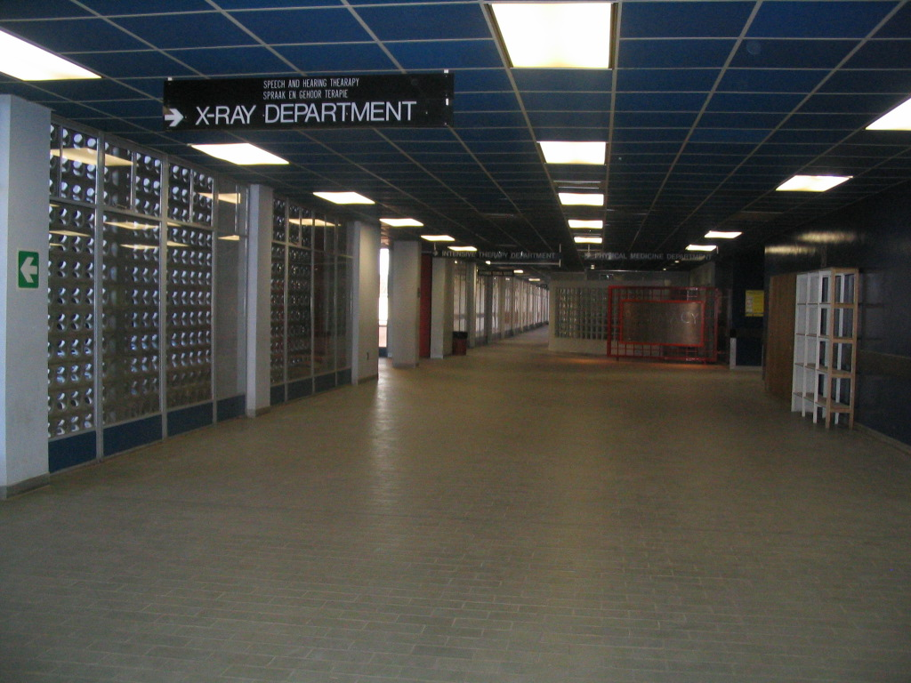
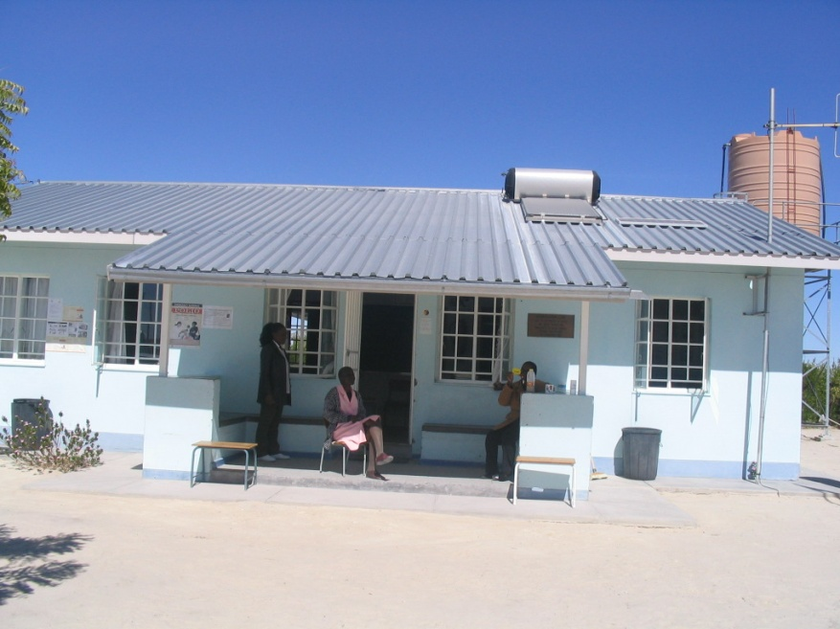
Digital Divide
Otjimanangombe Primary Healthcare Clinic opened 4 July 2008.
Urban Setting

Slide 11
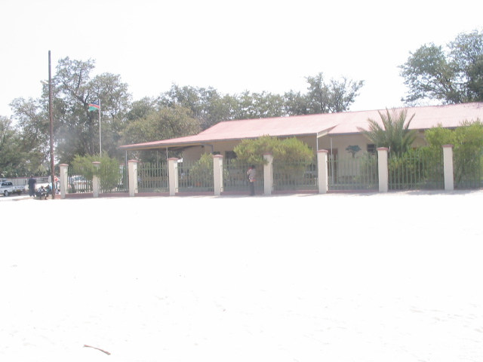
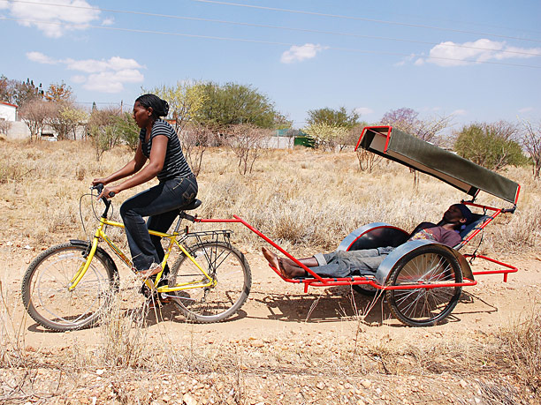
Digital divide
Source: BEN Project
Okatana Health center

Slide 12
How is patient data,case reports and disease control records tranferred across healthcare levels of the Namibian system?

Slide 13
Preliminary Results
Efficacy of telemedicince as a means of bridging the gap between health care levels
Design science theory to diagnose the research
Data management problems and information flow in the Namibian health system will be carried out in order to identify the action of intervention.
Delphi method of study forvalidating the model
Design the Telemedical-computing infrastructure for the Namibian Healthcare system

Slide 14
Preliminary results
Converging healthcare conceptual model
WHO - Benchmark for baseline systems
Lessons from South Africa

Slide 15
Future Research
Refining and implement the model
Design telemedical- infrastructure for the Namibian Context.
Lessons to learn from South Africa given the similarities in the two systems

Slide 16
Thank you
?

Slide 17
Bibliography
Checkland, P. (1991), ``From framework through experience to learning: the essential nature of
action research'', in Nissen, H.E., Klein, H.K. and Hirschheim, R. (Eds), Information
Systems Research: Contemporary Approaches and Emergent Traditions, IFIP, ElsevierScience Publishers, B.V. North-Holland, pp. 397-403.
http://www.benbikes.org.za/
Khan, T., Edwards, D., Health, G., Assistance, T., & Project, B. (2012). ASSESSMENT OF NATIONAL HEALTH INFORMATION SYSTEMS. Retrieved from www.ghtechproject.com
Ngwenyama, O.K. (1991), ``The critical social theory approach to information systems: problems
and challenges'', in Nissen, H.E., Klein, H.K. and Hirschheim, R. (Eds), Information Systems.Research: Contemporary Approaches and Emergent Traditions, IFIP, Elsevier SciencePublishers, B.V. Amsterdam, pp. 267-80.
MOHSS (Ministry Of Health and Social Services). (2008). GOVERNMENT OF THE REPUBLIC OF NAMIBIA. Windhoek. Retrieved from www.healthnet.na
Namibia. MOHSS.1999.The health sector and health sector reform in Namibia. Windhoek: Directorate: Policy, Planning and Human Resources Development.
Shivute, M.I.(2007).”The use of Information and Communication Technology for Health Service Delivery in Namibia”.Cape Penisula University of Technology, Cape Town.

