Slide 1
The Need for Health Informatics (HI) Professionals
Neil Gardner, MPA, CPHIMS-CA
President, COACH
HISA Conference, Port Elizabeth, SA

Slide 2
Presentation Outline
Canada’s eHealth journey
Some lessons learned to date
COACH’s Health Informatics (HI) Professionalism strategy and services
Questions ???

Slide 3
Canada’s eHealth Journey

Slide 4
The Canadian Context
Publicly-funded healthcare “system”
Federal policy leadership with portable benefits
Provincially delivered healthcare systems (10), with some privately delivered components
Increasing public awareness of cost pressures and demand for accountability of investments
National architecture and investment program (Canada Health Infoway)

Slide 5
Continuing increase in the use of interoperable systems by clinicians in providing care
Clinical Telehealth Consultations
Electronic Medical Record Users
(of 48,000)
Diagnostic Imaging Systems Users
Drug Information Systems Users
187,385
187,385
45,455
30,123
18,720
18.753
30,955
11,040
9,615
30,955
505%
70%
142%
213%
Percent increase in users and consultations over a 6 year period
Sources: Pan Canadian Telehealth Benefits Report, 2011, National Physician Survey, 2000, 2006, 2009, 2011 & Commonwealth Fund, Infoway Diagnostic Imaging Program Data, 2005-2011, Infoway Drug Information Systems Program Data, 2005-2011
5

Slide 6
Current state – estimated aggregate benefits
7
Inclusive of all benefits documented and estimated in Infoway’s pan-Canadian benefits reports
(available at: https://www.infoway-inforoute.ca/index.php/progress-in-canada/benefits-realization)
Notes:
Inclusive of all benefits documented and estimated in Infoway’s pan-Canadian benefits reports (all available at: https://www.infoway-inforoute.ca/index.php/progress-in-canada/benefits-realization)
Benefits reflect investments of both Infoway and its jurisdictional partners.
Some solutions pre-date Infoway investments (e.g. BC PharmaNet, existing PACS, etc.,).
Other solutions were not Infoway funded at the time of the reports (e.g. EMRs which generate printed/typed prescriptions)
DI study used 2008 data, DIS used 2009 data, and telehealth used 2010 data. All values were adjusted for inflation using the Statistics Canada Health Care Index and reflected in 2011 dollars.
Data prior to/post respective pan-Canadian study was estimated using observed growth rates and system implementation and/or user adoption data.
All pan-Canadian studies were commissioned by Infoway from independent third parties and were validated by external subject matter experts.

Slide 7
Emerging Opportunities for eHealth
10
Bring Care Closer to Home
Patient Monitoring
Personal Health Record
Provide Easier Access
e-RxRenewal
e-Visits
e-Scheduling
e-Navigation
Support New Models of Care
Electronic Health Record
Discharge Summaries
Referral Management
Chronic Disease Management
Care Transitions
Telepathology
Improve Patient Safety
Hospital Medication Management
Medication Reconciliation
e-Prescribing
Enhance a High-Performing Health System
Clinical Analytics
Health System Analytics
Population Health
LEAN
COACH: Canada's Health Informatics Association

Slide 8
….. But the Enablers Need to be in Place
11
Policy & Legislation
Resource Capacity, Capability & Culture
Governance & Leadership
Practice & Process Change
Bring Care Closer
to Home
Provide Easier Access
Support New Models
of Care
Improve Patient Safety
Enable a High Performing
Health System
Privacy & Security
Business Case & Benefits Realization
Interoperable eHealth Solutions
COACH: Canada's Health Informatics Association

Slide 9
Impacts of Strategic Investment
Strategies for information, inter-operability, standards & e-Health deployment – require collaboration, shared vision and strong buy-in
Increased demands & expectations; more complex & integrated technologies; concerns about privacy, value and patient safety
People entering industry (from IT, management, clinical and other backgrounds) without prior exposure to health informatics
This has resulted in:
Need for multidisciplinary health informatics professionals, given the interplay of technological, information and clinical dimensions
New programs emerging to train HI professionals from “scratch”, as well as augmenting the skills of those in the industry already
Requirement for raising the profile of HI and continually advancing our practices (professionalism)

Slide 10
Some Lessons I’ve Learned along our eHealth Journey – a ‘Top 10’
eHealth is often a tough sell – cultivate strong sponsors
Importance of leadership, common vision and collaboration
Common destination, architecture & standards – but multiple paths (be prepared to make course corrections!)
Use small steps, show results & continually learn and adjust
Don’t drive change – enable it by supporting health system priorities and ensure strong provider & consumer/patient engagement
Let’s not forget why we are doing this – better & safer health
Focus on the information & business processes, vs. the technology
Change management, governance & project management are vital
Manage expectations – achieving benefits requires sustained effort
Don’t neglect the value of data for improving the health system
Capacity must be developed along the journey to ensure sustainability

Slide 11
COACH’s HI Professionalism Approach

Slide 12
About COACH
Founded in 1975
Membership is composed of:
Academic Institutional Members & students – 15%
Private sector institutional members – 30 %
Public sector institutional members – 30%
Individuals – 25%
Funded through membership dues and revenues from conferences and products

Slide 13
COACH’s Strategic Focus Areas
Four distinct but mutually supporting elements:
Professional Development
Best practices & Knowledge
Collaboration & Influence
Conferences & Events

Slide 14
COACH programs
Best Practice Guidelines
Privacy & Security (includes special editions)
Human Resources recruitment
eHealth Safety (under development)
Forums and special interest groups
CHIEF – public & private sector executives
Canadian Telehealth Forum
Emerging Professionals Forum
Clinician Forum
Special interest groups (e.g. Information governance)
Collaborations with Canadian & international partners
PROFESSIONALISM

Slide 15
COACH HI Definition
Health informatics (HI) is the intersection of clinical, IM/IT and management practices to achieve better health.
COACH has defined a set of 50 core competencies that are needed by all HI professionals to work effectively as a team
Notes:
15
The knowledge, skills, attitudes, and capabilities necessary to effectively perform as a health informatics professional

Slide 16
HIP Core Competency Areas
Information Management
Information Technology
Clinical & Health Services
Canadian Health System
Project Management
Organizational & Behavioural Management
Analysis & Evaluation

Slide 17
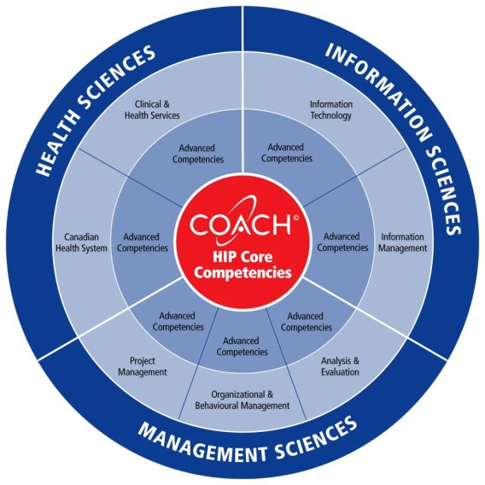
HIP Core Competencies & Framework
The working definition of HI and core competencies were the foundation for our other professionalism work
Defined through series of workshops with experts from the field
Not a job analysis – looked forward to the ideal competencies required by an HIP, not just those commonly in practice today
Originally developed in 2007; updated in 2009 & 2012
Validated through development of the Role Profiles
International collaboration – e.g. with US, Brazil, etc.

Slide 18
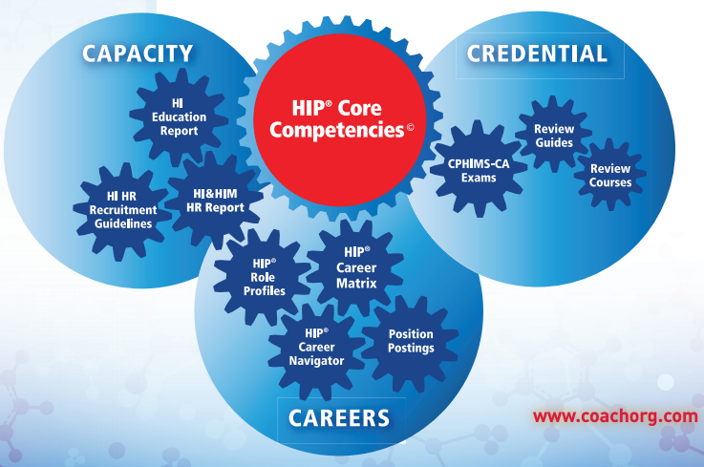
Notes:
Record who attended and indicate whether or not they: 1. will not take exam; 2. will take exam; or 3. thinking about it
Record questions so we can update this presentation

Slide 19
Human Resources Capacity
First ever national study of Canadian HI & HIM Human Resources, conducted in 2009
32,500 HI & Health Information Management (HIM) “professionals” working in Canada
Vacancy rates as high as 25% for some key groups
Central conclusion: Canada needs more HI professionals with a broader range of skills
Much of our existing workforce needs broader skillsets
Between 6320 and 12,330 new hires needed over the next 5 years

Slide 20
Labour Market Risks - from an under-supply of professional skills:
Delays and cost over-runs
Sub-optimal implementations
High turnover & recruitment delays
Diminished morale & performance
Most importantly, risks to patient safety and organizational performance
The challenges & opportunities will not decrease – in times of constrained resources, the quality, skills & versatility of our teams will be paramount

Slide 21
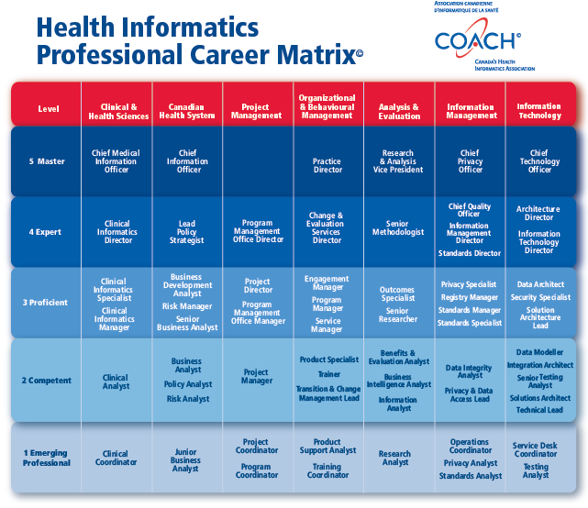
Where do we get more qualified people?
5
We need to think ‘outside the box’ - both in terms of recruiting Health Informatics Professionals as well as other complementary “team members”
Specialists
(e.g. in process improvement – LEAN)
4
-
-
Difficult to replace skills
3
2
Champions & Informed End-Users
Core Workforce
(e.g. IT staff)
-
1
1
2
3
4
5
Impact on long-term HI value chain
Notes:
21

Slide 22
Tactics for Building Capacity
Actively collaborate with Health informatics education programs on curriculum and increase the awareness and knowledge of HI with our stakeholders
Support educators, students and emerging professionals through special programs
Foster recruitment, continuous learning, and sharing of best practices via events, communities of interest, etc.
Provide tools to assist organizations and professionals with HI career planning, recruitment & retention

Slide 23
Careers
HIP Career Matrix
Outline of HI roles and levels and associated experience and education – cross-section of leading HI delivery organizations (public & private)
HIP Role Profiles
Description of each role on the career matrix
HIP ‘Career Tool’ (under development)
Will allow for self-assessment, comparison and career planning by organizations and individuals
Based on role profiles and typical career paths

Slide 24
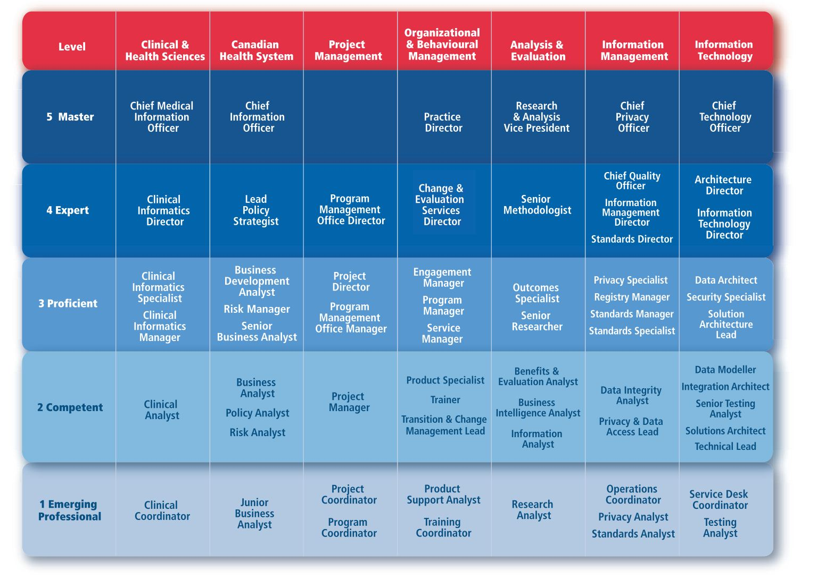
Health Informatics Professional (HIP) Career Matrix

Slide 25
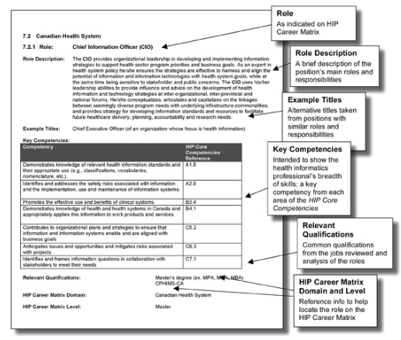

Slide 26
CPHIMS-CA Credential
Comprehensive
Our credential demonstrates knowledge of the Canadian environment & broader Health Informatics knowledge
Professional-level
Must have a combination of education and experience to challenge the exams
Ongoing renewal requirements
Ensuring skills and knowledge are kept up to date

Slide 27
CPHIMS-CA – Certifying…
CPHIMS-CA exam content
Addresses the set of 50 COACH core competencies that are needed by all HI professionals to work effectively as a team
Notes:
27
The knowledge, skills, attitudes, and capabilities necessary to effectively perform as a health informatics professional

Slide 28
In Conclusion
eHealth strategy developed through collaboration and supported by an architecture and standards is critical for enabling improved health care
Health Informatics professionals are key to enabling and sustaining these investments
eHealth is a journey with many challenges - but full of opportunities for enabling better health

Slide 29
Questions??
COACH: Canada’s Health Informatics Association
www.coachorg.com

