Slide 1
Mental Health Informatics
Stoffel Grobler
Elizabeth Donkin Hospital and WSU Medical School

Slide 2
Overview of Discussion
Potential utility of mental health informatics within the integrated primary healthcare and district health system through the use of available technology
Improving transfer of knowledge between practitioners in rural areas and academics – the EDH attempt

Slide 3
What is Health Informatics?
It is a discipline at the intersection of information science, computer science, and health care.
A scientific field of study that deals with the
  acquiring, storage, retrieval, and processing
  of medical, biological and associated data, information and knowledge
  for the purpose of problem solving and decision making

Slide 4
Why Health Informatics?
Health Informatics provides information to make decisions
Better information leads to better decisions
Health care, management, planning and policy all need good information

Slide 5
Tools
Health informatics tools may for example include:
  Mobile phones
  Computers
  Clinical guidelines
  Policies and Procedures
  Clinical protocols
  Clinical Documentation
    includes clinical notes, files of patients documents used to record and transmit a patients' history, condition, responses, therapies, activities, and treatment plan
  Telephone Number Lists – staff and patients
  Electronic documents used to collect information and web links for a common clinical group
  Emails, Posters, and Staff Meetings

Slide 6
Current challenges in the system
Revolving door syndrome, repeated re-admissions
Patient relapse due to non-compliance and lack of insight
Substance abuse
Clinics running out of medication
Lack of dependable data bases
Monitoring information and administration of information of patients

Slide 7
Quote
Professor Jannie Hugo:
  “Every problem has an address”
  Add – and most likely a cell phone!

Slide 8
Aim
Relapse prevention
Early detection of signs of relapse
Frequent follow-up
Psycho-education
  Dissemination of information to patient
  Reminders to clinic visits
Improved adherence
Improved accessibility of services
  Patient can sms
  Family can sms

Slide 9
Potential benefits
Aim: keep patients healthy in the community through frequent follow up using cell phone technology
Early detection of signs of relapse
Dissemination of information to patient
Improved adherence
Improved accessibility
  Patient can sms clinic nurse
  Family can sms nurse
  Nurses can do home visits

Slide 10
Other spinoffs
Improved statistics
Allocation of resources
Planning of outreach services

Slide 11
Minister of Health: Dr Aaron Motsoaledi
Speech by the Minister of Health Dr Aaron Motsoaledi at the opening of the Medical Informatics Congress, September 2010, Cape Town
We need timely and accurate health information for various reasons such as patient management, disease control and prevention, service delivery, resources allocation and planning, monitoring, reporting and evaluation.
We also need information to demonstrate evidence whether our policies, strategies and interventions are effective in reducing the burden of disease.

Slide 12
Minister of Health: Dr Aaron Motsoaledi
For the health sector, the priority is improving the health status of the entire population and to contribute to Government’s vision of “A Long and Healthy Life for All South Africans”
The outputs for achieving this vision are:
    Increasing Life Expectancy
    Decreasing Maternal and Child mortality
    Combating HIV and AIDS and decreasing the burden of diseases from Tuberculosis
    Strengthening Health System Effectiveness

Slide 13
Minister of Health: Dr Aaron Motsoaledi
This requires a health management information system that is capable of providing real time information at all levels of the health systems.
He concluded by challenging participants and delegates to reflect critically the accessibility, appropriateness, affordability and cost-effectiveness of health information systems and information communication technologies as well as their practical applications in local, less developed and resources constrained settings.

Slide 14
To Recap
Information is data that has been processed and understood by the recipient
Health informatics has application within all aspects of healthcare delivery and promotion
Leads to improved monitoring and administrating information about patients

Slide 15
Recap
Conventional approach is to collect information about patients using a paper based system
Since time is of the essence, data exchange between hospitals, district services and decision making bodies is becoming more important
The logical response is a computer based system –which will collect mental health related information within the local context
Challenges in this regard however would be procurement, servicing, internet connections etc. etc. etc.

Slide 16
Community Oriented Primary Care
– the Tshwane health post model
An example of how things can be done is the Tshwane Community Oriented Primary Care (COPC) model using mobile phones, sending data to a central area, which is then processed by actuarial sciences.
COPC has been summarily described as ‘the merger of front line clinical medicine with public health’
  Bam et al, 2013
  Susser M, 1993

Slide 17
The Health Post Model
The health post is developed as a service unit that is physically located in a community and serves the population in a defined geographic area within a specific municipal ward
Comprises a health post manager and between 20 and 40 CHWs - proportionate to the number of households served.
The health post manager is a professional nurse and the CHWs are recruited from the communities surrounding the health posts. This approach enables the team to work from a sound understanding of the local culture and idiom, although there is the risk of overfamiliarity and problems associated with privacy
Kautzky K, 2008
Kinkel et al, 2012

Slide 18
The Health Post Model
The health status assessment data is captured electronically by the health post team using mobile phones. The data is transmitted to a web-based data platform.
It is then kept at the health post as a family file.
Using daily electronic reports on all CHW visits and interventions, as well as additional verbal reports from CHWs, the health post manager is able to allocate daily tasks and address health and social challenges for each household as they arise.
Kinkel et al, 2012

Slide 19
The Health Post Model
The family files are also confirmed, refined and updated through regular home visits.
In addition, data is aggregated for community level assessments and broad strategic health campaigns.
The health post team, together with district managers, the University of Pretoria and other collaborating partners, use this data to determine short, medium and longer term interventions.
Bam et al, 2013

Slide 20
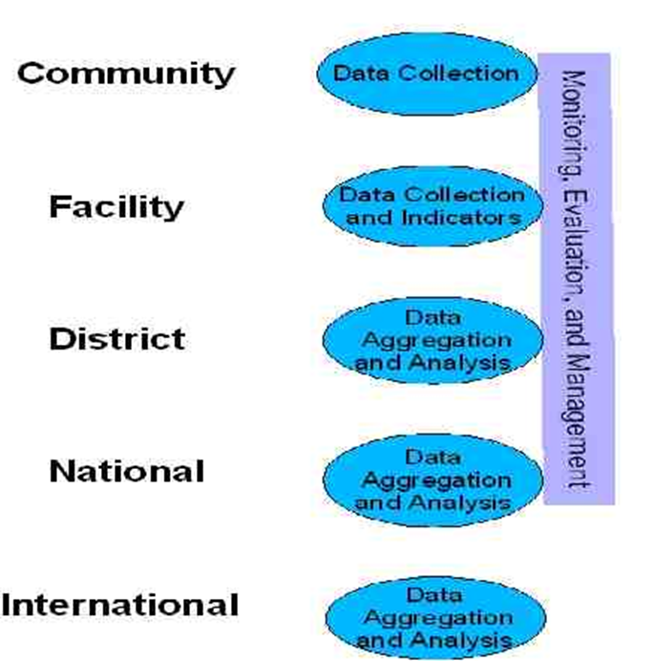

Health Information Systems Context

Slide 21
Goal
Ultimate goal is to improve the quality of health care, research and education in medicine and health
Notes:
The ultimate goal is to improve the quality of health care, research and education in medicine and health

Slide 22
Continued Professional Development
Improving transfer of knowledge between practitioners in rural areas and academics – the EDH attempt
Friday Academic Program
Complete Multi-disciplinary Team involvement in terms of presenters
Presentations video recorded
Saved on DVD
Library in Pharmacy
There for “rental” by interested professionals with limited access to CPD opportunities e.g Tower Hospital

Slide 23
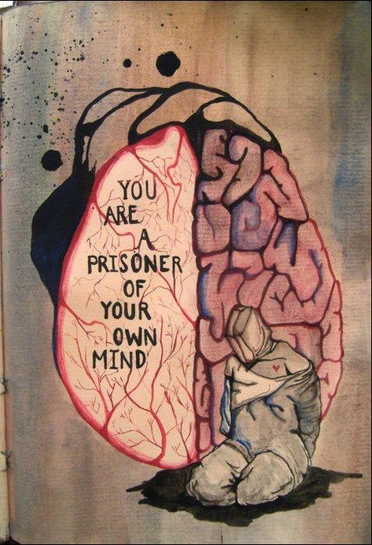
End

