Slide 1
Rwanda HIE | RHEA
Wayne Chelliah Naidoo
Technical Project Manager
Jembi Health Systems

Slide 2
Glossary
Term | Definition
RHEA | Rwanda Health Enterprise Architecture Project
HIE | Health Information Exchange
SHR | Shared Health Record
CR | Client Registry
PR | Provider Registry
FR | Facility Registry
TS | Terminology Service
HIM | Health Information Mediator
PoC | Point of Care

Slide 3
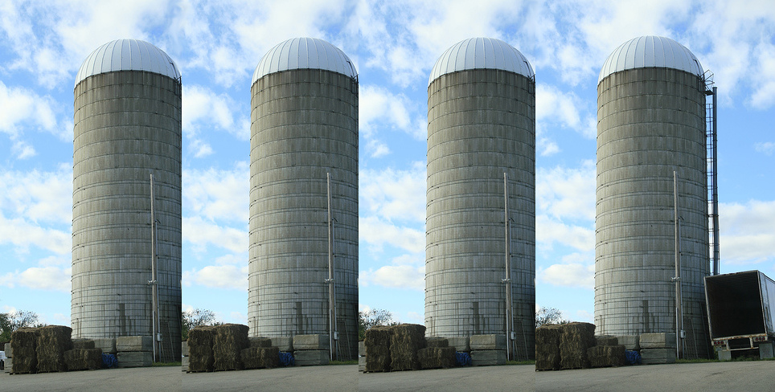
Common HIS landscape (Information Silos)

Slide 4
Challenges in Low Resource Settings
Poor infrastructure
Intermittent
  Power
  Internet
Users not sufficiently computer literate

Slide 5


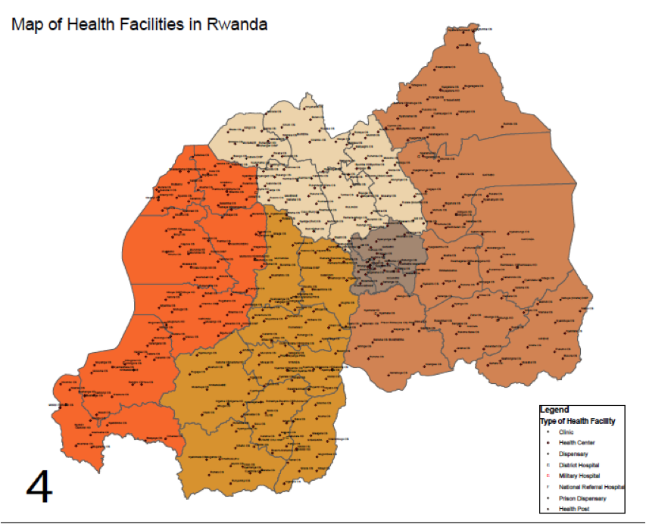
Rwanda
Improving Interoperability for Maternal and Child Health in Rwamagana District

Slide 6
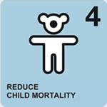

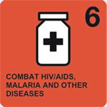
Goals
Giving health care providers a better picture of their patients medical history
Increase the number of pregnant women accessing ante-natal care services
Increase the number of HIV-positive pregnant women accessing PMTCT services
Improve progress in implementing MDGs 4, 5 and 6 (lower incidences of maternal and child mortality and HIV/AIDS)

Slide 7
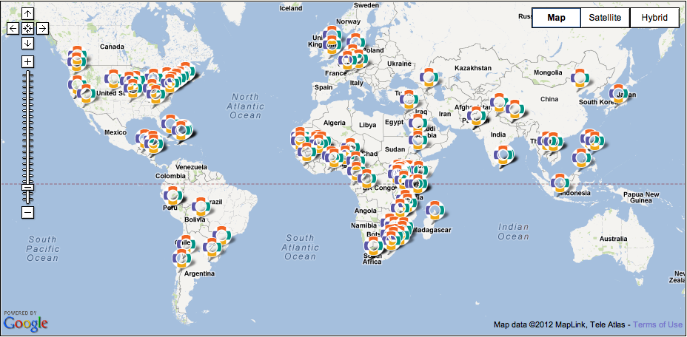
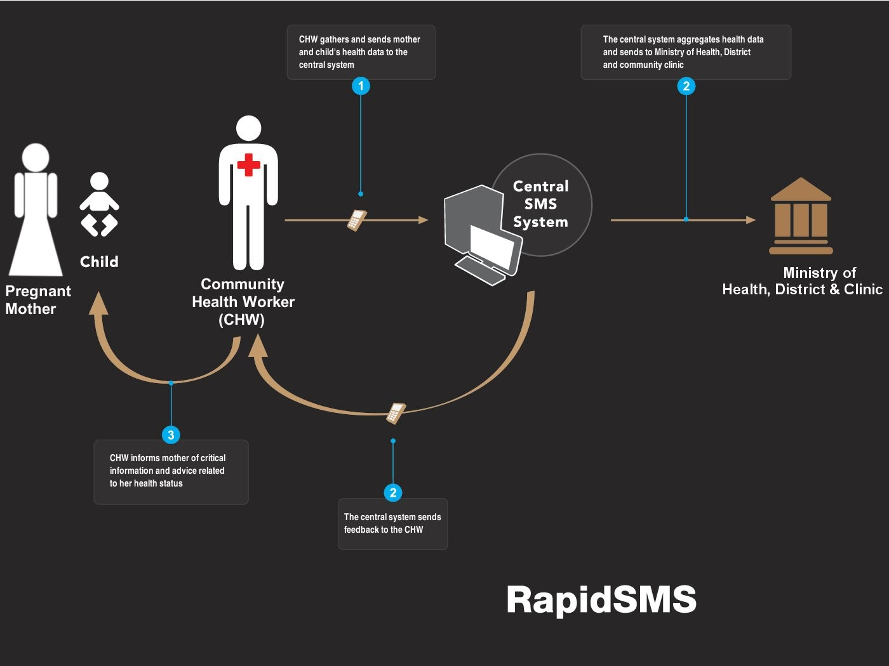
Atlas of known OpenMRS Implementations

Slide 8
Rwanda Health Enterprise Architecture (RHEA) Project
RHEA is an initiative of the Rwandan Ministry of Health eHealth Coordination Unit.
RHEA seeks to develop and implement an health enterprise architecture for Rwanda.

Slide 9
Rwanda HIE
A project within a project
  Rwanda HIE within RHEA
Implementation and instantiation of a HIE based on the data from RHEA
  Requirements
  Workflows
  Objectives
  Standards
  all utilized within the development process

Slide 10
HIE Architecture

Slide 11
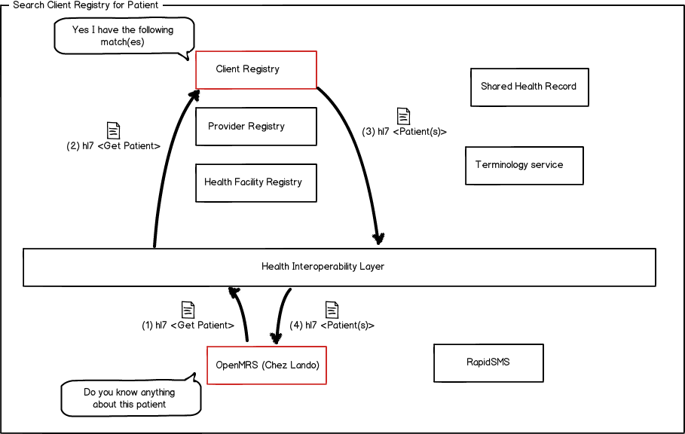
Patient Search

Slide 12
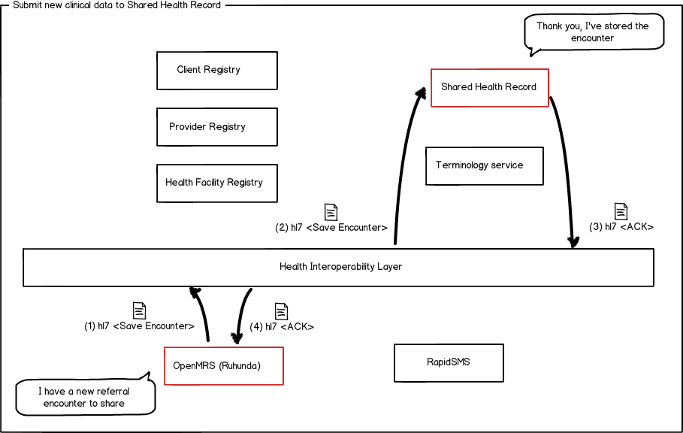
Sharing patient data across facilities (Posting new information)

Slide 13
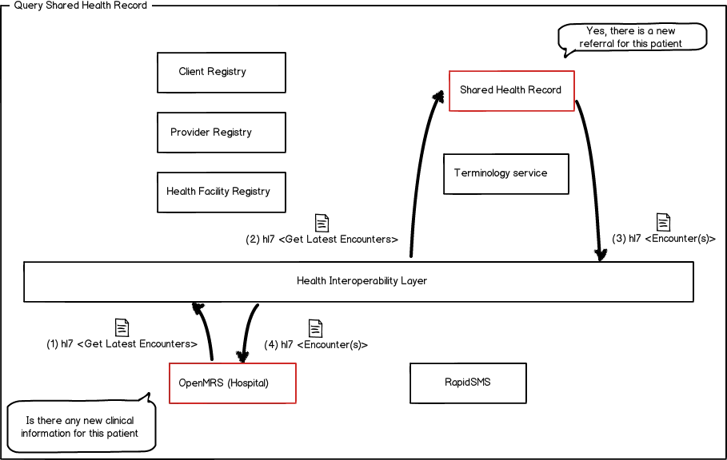
Sharing patient data across facilities
(Retrieving information)

Slide 14
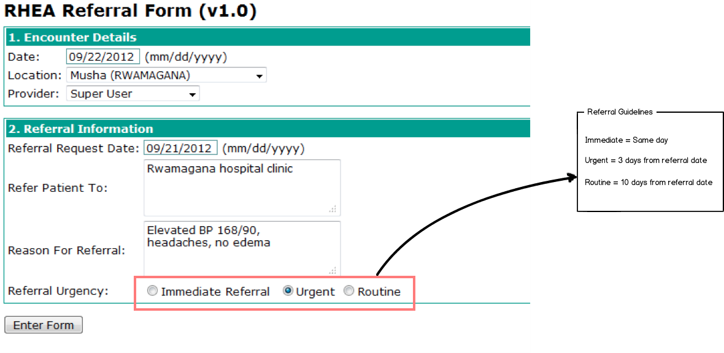
Referral Guideline

Slide 15
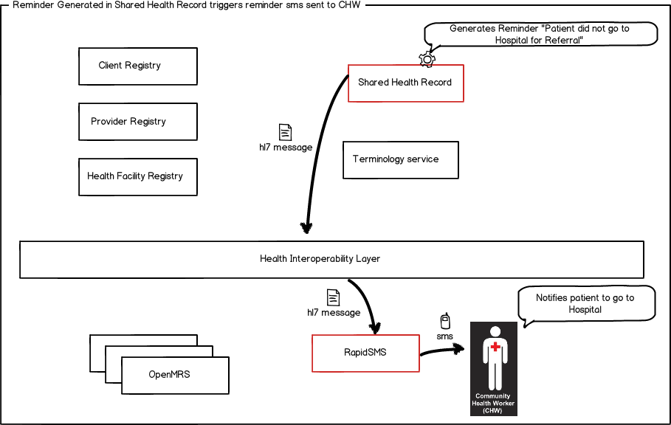
Automated Reminders via SMS

Slide 16
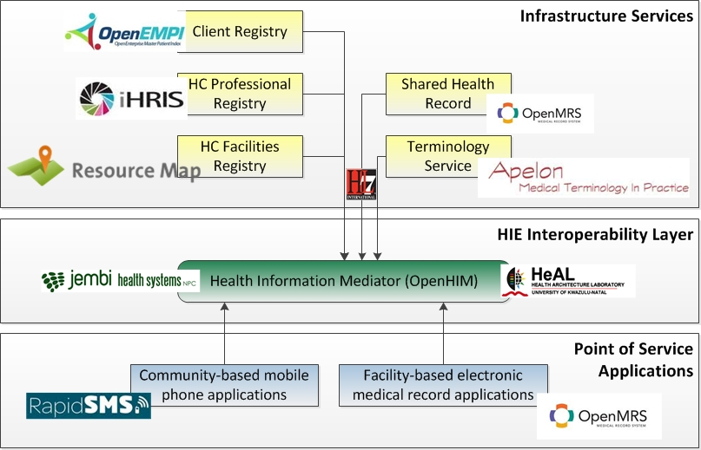
HIE Stack

Slide 17
Project History and Timeline
A Brief Project History and Timeline

Slide 18
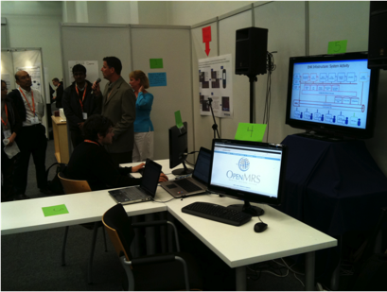
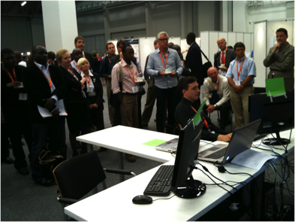

Timeline
September 2010:
  Medinfo Demo
  First Demonstration of Architecture
TIME
LINE
2010
2011
2012
2013

Slide 19
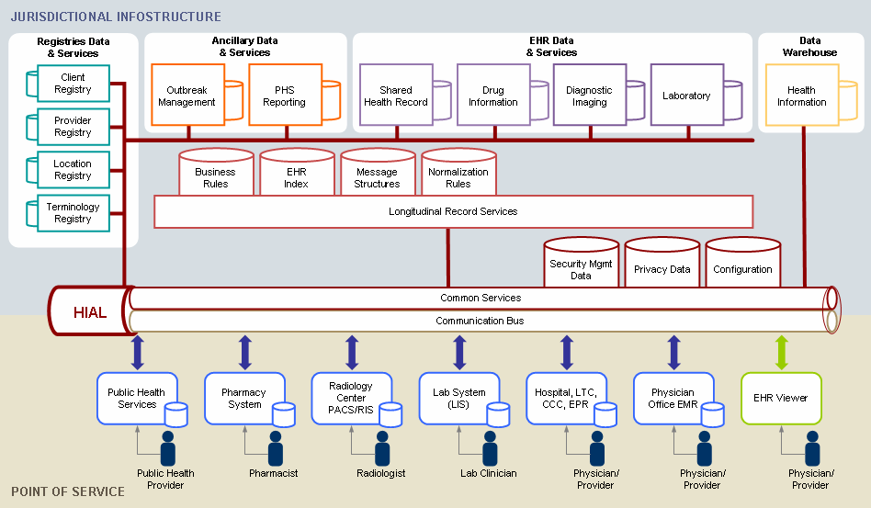
Canada Health InfoWay EHR Architecture

Slide 20
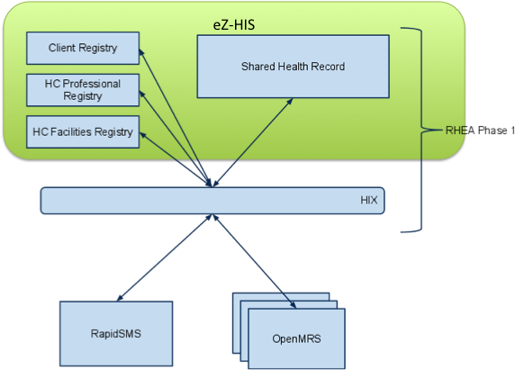
Timeline
March 2011
eZ-Vida stack Demonstration
Kigali
TIME
LINE
2010
2011
2012
2013

Slide 21
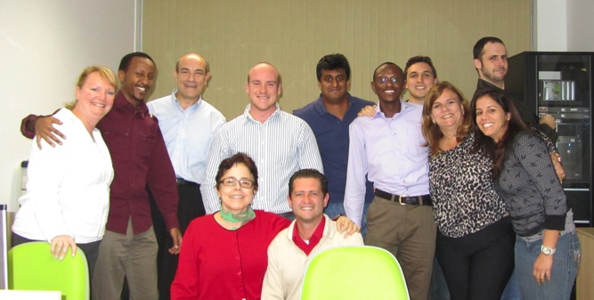
Timeline
June|July 2011
eZ-Vida Training, Brazil
Technology insight / exploration
TIME
LINE
2010
2011
2012
2013

Slide 22
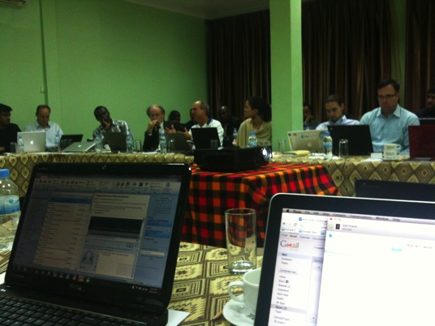
Timeline
October 2011
Low Hanging Fruit Project (LHF v1.0)
  Facility Registry
Kigali, Rwanda
TIME
LINE
2010
2011
2012
2013

Slide 23
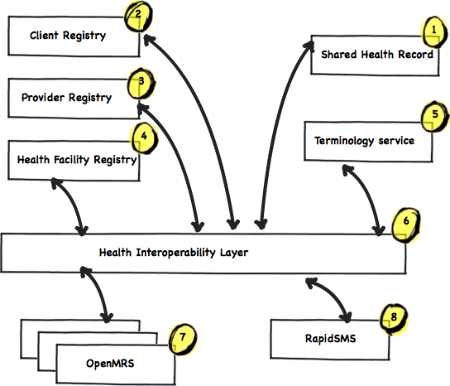
Timeline
March 2012
LHF v1.5
Move to new architecture
TIME
LINE
2010
2011
2012
2013

Slide 24
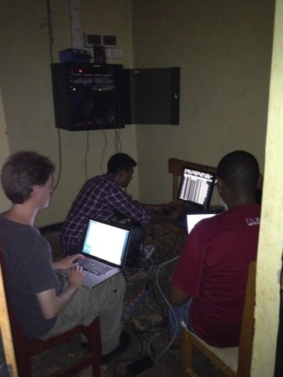
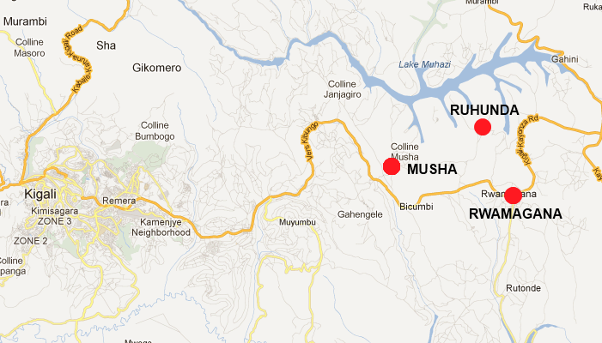


Timeline - Today
September 2012:
  Rwanda HIE live in NDC
  2 Sites Deployed
TIME
LINE
2010
2011
2012
2013

Slide 25
Implementation Findings
Low resource settings provide opportunities for advanced health information systems development and implementation
Constraints on capacity and other resources promote the development of good practices
Open technologies will play an increasingly important role in low resource environments
Investment in local capacity development takes time but provides valuable in-country expertise towards ongoing support past the “project” into the “Programme”

Slide 26
Development Findings
Scope creep is inevitable and required managed expectation.
Plan for the unexpected – things change and projects need to adapt.
Look past the software towards the solution – software is not the solution; it is part of it, ensure users are considered and implementation needs addressed too.
Ensure the system speaks the local language – adoption by users is key to success so accommodate as much as possible.
Beware of physical boarder restrictions on data (i.e. Data not allowed to leave country).
Plan for change and expect delays outside of your control (have mitigation strategies)
Be agile AND structured! Show impact of decisions.

Slide 27
Team Overview
Ministry of Health, Rwanda
Jembi Health Systems, South Africa & Rwanda
Regenstrief Institute, USA
InSTEDD, USA
Pivot Access, Rwanda
IntraHealth
SysNet International
Apelon
HEAL, University of KwaZulu-Natal, South Africa
Liz Peloso
Mead Walker
Partners in Health
Millennium Villages Project
World Health Organization
Nethope
Mohawk College
ecGroup
Open Health Tools
HingX
BLeao Informatica em Saúd, Brazil
eZ-Vida, Brazil
CDC, USA

Slide 28
OpenHIE
OpenHIE is an open source community of practice, that encourages reuse of common technologies and approach.
OpenHIE emerged from the RHEA experience

Slide 29
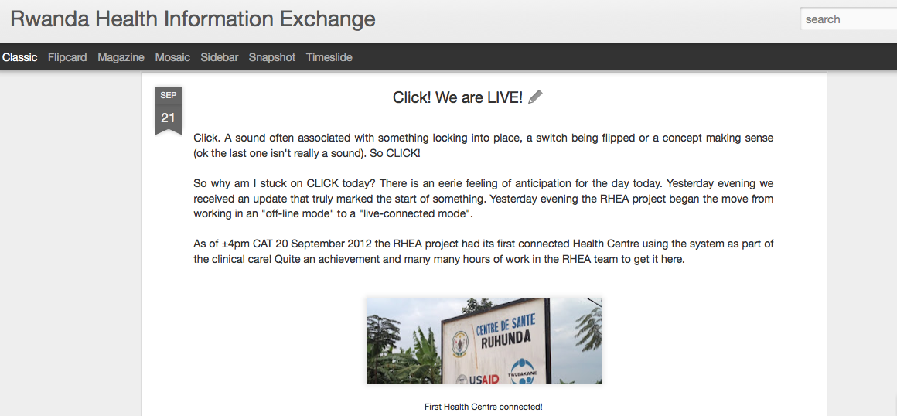
Implementation Blog
Carl Fourie, Jembi Health Systems, 21 September 2012, http://rwandahie.blogspot.com/

Slide 30
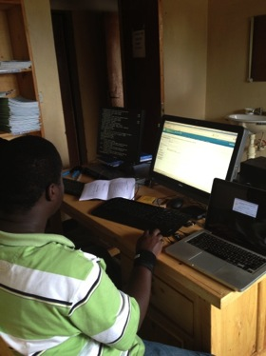
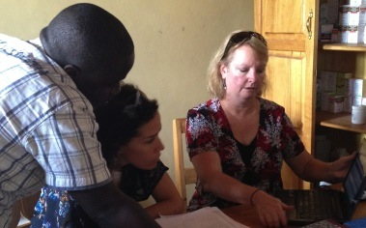
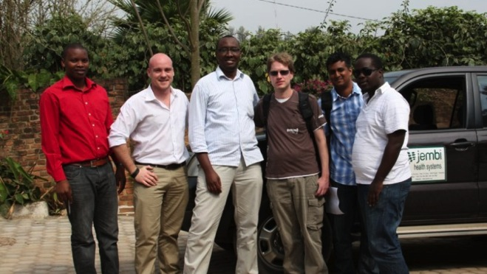
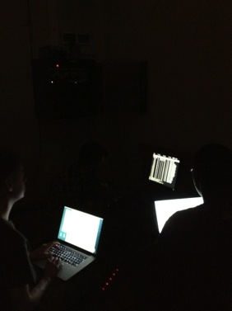
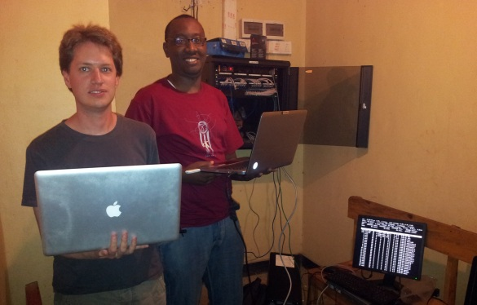
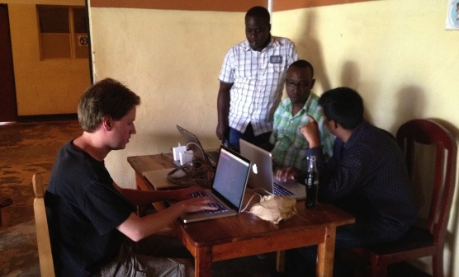
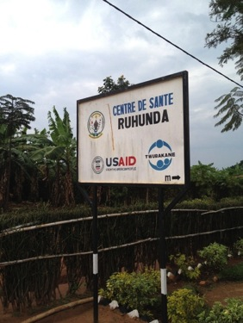
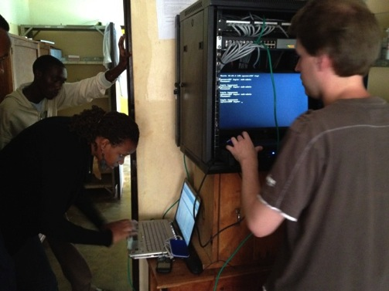
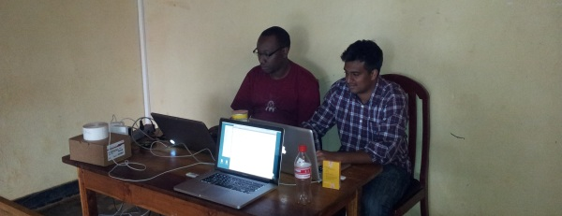

Slide 31

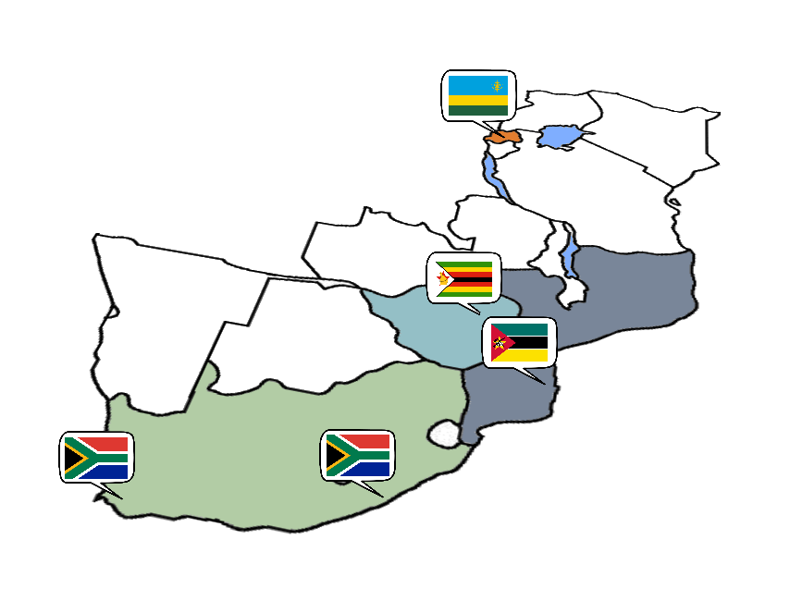
Thank you
Mozambique
Avenida Julius Nyerere no 3326
Condominio Diplomatic Village
Casa numero um
Maputo
Rwanda
Kacyiru Road
Plot Number 1760
Kigali
South Africa

