Slide 1
Developing a framework for district-based mental health information system for Western Cape
HISA conference 2013, Port Elizabeth, South Africa,
M. Bimerew ,PhD student, University of the Western Cape
Prof. O. Adejumo, University of the Western Cape (supervisor)
Prof. M. Korpela, University of Eastern Finland, & CPUT (co-supervisor
Email: mbimerew@uwc.ac.za
3-5July2013

Slide 2
Outlines of the presentation
Back ground of the study
objectives
Research Methodology
Study participants
Data analysis
Results
Recommendations

Slide 3
Background information
  Lack of MH information processing, and low political prioritization about MH ( Omar, et al., 2010)
  There is little available info been processed about the nature and type of MHI at district health services.
  MHIS for monitoring Community-based MH care and staff are weak in SA (WHO,2010)
  Info on diagnosis, length of admission, gender & age distribution of mental illness are not routinely recorded (WHO,2007).
  MH data remained to be inadequate & unreliable for planning effective Community-based MH services
  There is lack of MHIS planner & coordinator.
  People dealing with HIS, don’t have an understanding
  about MH (WHO,2004)

Slide 4
Objectives
To explore the current MH information processing system at district health services
To assess mental health care information flows/networking
To determine the challenges in MHIS at district mental health services
To gather information on successful functional elements for DMHIS

Slide 5
Research methodology
Qualitative research:
Semi-structure interviews
FGDs
Document review
Systematic review

Slide 6
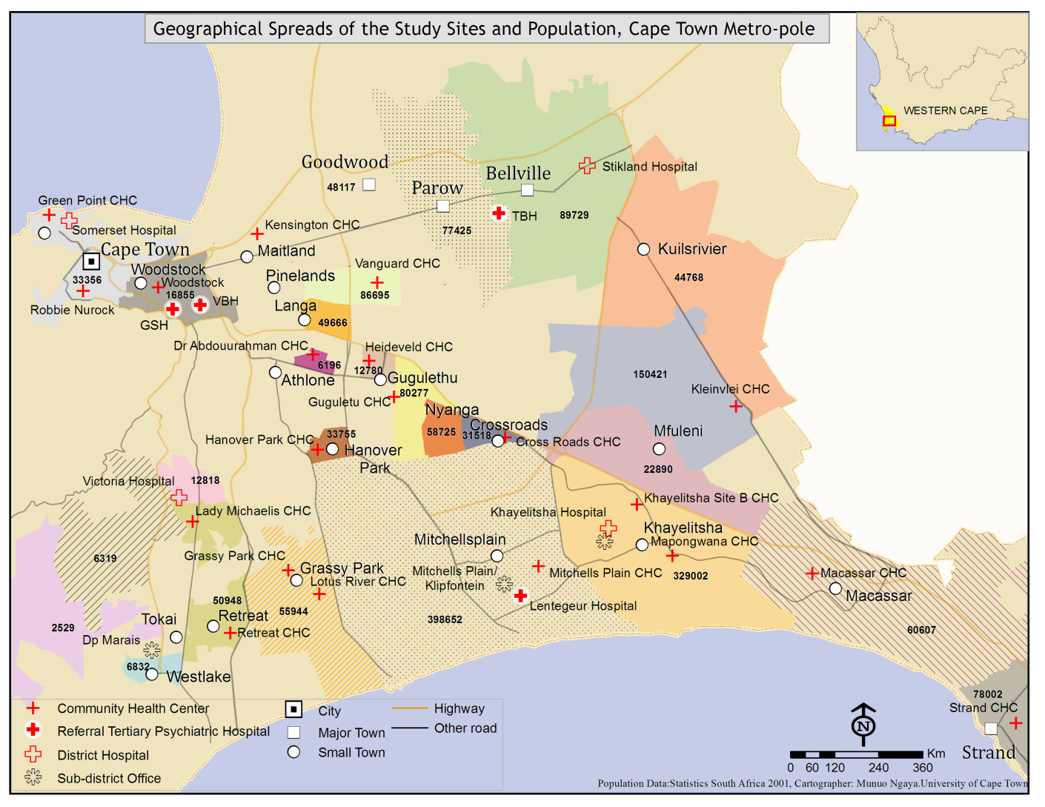
Study sites: Cape Metro pole area

Slide 7
Study participants
Facility Manager(N=14), Mental Health care providers (N=23), info officers/Clarks(N=13) & Caregivers(N=11)
Two FGDs with caregivers( each group had 8 participants)
Documents analysis from 3 selected health facilities
Data was analysed using content analysis, thematic categorization & synthesis

Slide 8
Results: six major gaps were identified
DMH Information system
Info. collection tools & contents
Information Infrastructure
Information processing
Information competency
Quality of information
Resuorces

Slide 9
Information collection tools & content
Lack of standardized information collection tools;
No consensus based MHMDS;
No report on patient socio-demographic characteristics and diagnosis & treatment; Info collected & reported are insufficient to inform policy & decision making-e.g. head count reporting(chasing the number). Affect quality of health care provision;
Information infrastructure:
Lack of IT structure, lack of IT skilled personnel;
Information flow policy unknown to staff;
Lack of coordination of vertical & horizontal info flow, &
Lack of system for analysis & utilization;
Organizational information culture are poorly developed

Slide 10
Information processing
No standard criteria for information processing & validation;
Poor feedback system;
Lack of understanding about the value of information;
Patient & caregivers receive insufficient information about the illness and treatment; waiting time for service is too long; info sharing session club was working, but why it is stopped?
Missing patient folders or misplaced; load of work & negative attitudes of health workers towards data collection & processing
Information quality recording:
Incomplete, inaccurate & inconsistencies in info recording & processing.
Poor info quality affect service planning, budgeting, preventive & promotive action of the community; unreliable and incomplete decision making process

Slide 11
Resources: organizational environment, technical, behaviour
Lack of facility management support system;
No organizational information processing rules, values & practices.
Lack of technical skills
Limited human power
Alienation & negative attitudes towards mental health
Information competency
No in-service training program in information collection and processing
Higher training institutions of medical and nursing schools are not yet responding the need to incorporate info competency into the curriculum
Lack of career development

Slide 12
Systematic review
370 research articles & text/opinion papers
241 research articles
27 articles retrieved after abstract reviewed
129 text & opinion papers
27 text/opinion paper retrieved after abstract reviewed
20 articles excluded: 12 not focused, 5 outcomes not relevant,3 duplications
13 articles
7 articles
14 text/opinion paper excluded: duplicates, not focused, no year of publication
5articles are included for extraction & synthesis
8 text papers are included for extraction & synthesis
2 excluded after full review
5 excluded after full review

Slide 13
Results of systematic review
Paucity of mental health information research.
What is found to be working
Community participation in design & implementation of info collection tools & content
IT structure for DMHIS
Information inputs, process & outputs
Organizational culture & support system
Staff empowerment

Slide 14
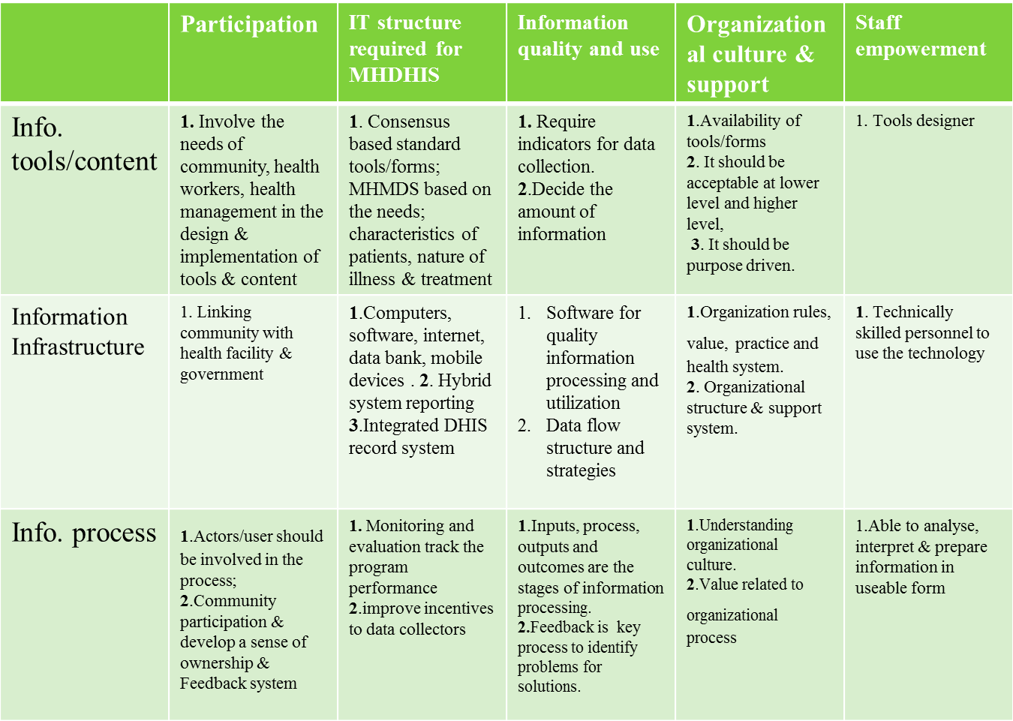
Matrix table

Slide 15
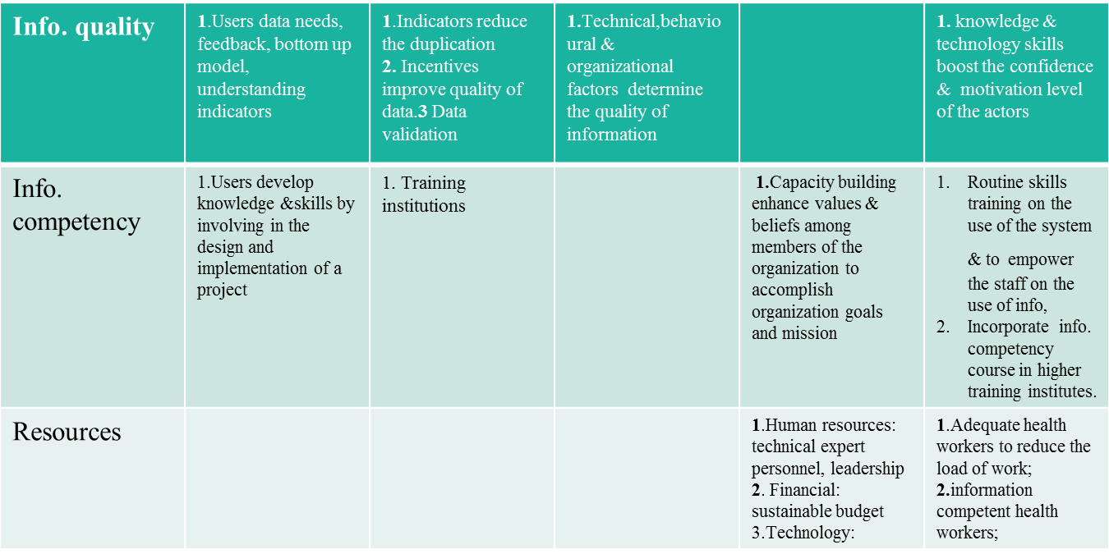
Matrix table cont

Slide 16
Recommendations
A framework for a district mental health information system.
To develop a user manual for health workers on mental health information system
Training institutions to incorporate information competency into the curriculum, & career development structure
More research on the link between information quality and improved health system
Improve management support system and mind shift

Slide 17
Questions for discussions
Does the head count reporting reflect the mental health problems in South Africa? If not what should be done better?
How district mental health information system should be developed in the integrated district health system?
Does developing IT solution for district mental health information system in LMICs improve the current situation?
What is the way forward?

