Slide 1

HISA 2013
Paul Woolman
Green Shoots
Or Blue Sky ?

Slide 2
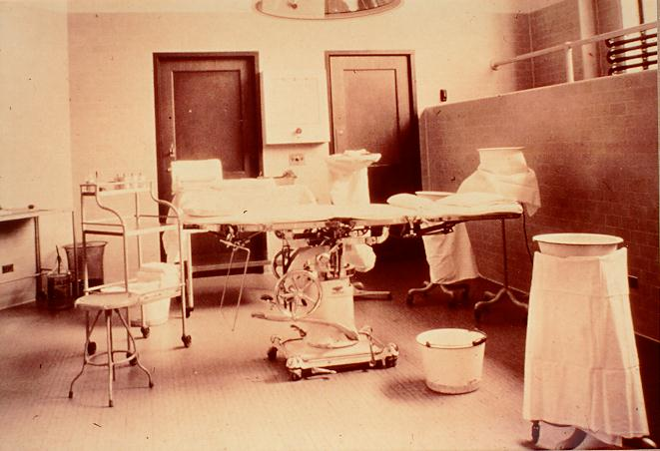
1935

Slide 3
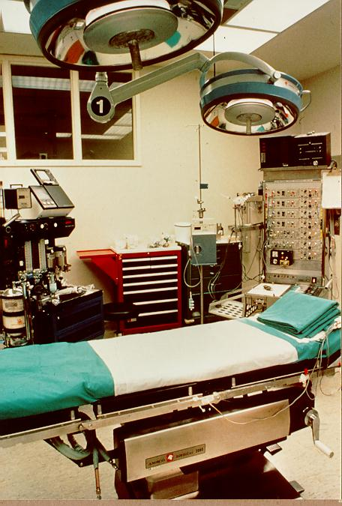
2013

Slide 4

1935

Slide 5
2013

Slide 6
The eHealth future is not a destination like Cape St Francis, waiting for our arrival; it is something like the Kruger Park that we have to imagine, plan and evolve

Slide 7

Challenges in
Scotland
Environment
Cancer
Cardio Vascular disease
Long Term Conditions
Deprivation
Obesity
Ageing population
Escalating costs

Slide 8
The Power of Information

Slide 9





1998
2000
2001
2003
2005
2008
2011
National Strategies

Slide 10
The future is here; it is just not evenly distributed
William Gibson

Slide 11
National Programme in England
“The aim is to implement integrated care records services (ICRS) records which are:
  integrated across all health and social care settings;
  designed around the patient, and not around individual institutions;
  therefore able to support the implementation of care pathways as part of National Service Frameworks.
Delivering 21st Century IT
National Specification for Integrated Care Records Service
July 2002

Slide 12
Successes of NPFIT
National network N3
PACS rollout
GP2GP record transfer rollout

Slide 13
Failures of NPFIT
“The aim is to implement integrated care records services (ICRS) records which are:
  integrated across all health and social care settings;
  designed around the patient, and not around individual institutions;
  therefore able to support the implementation of care pathways as part of National Service Frameworks.
Delivering 21st Century IT
National Specification for Integrated Care Records Service
July 2002

Slide 14
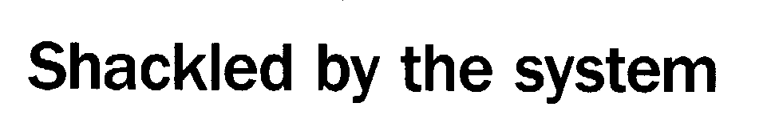


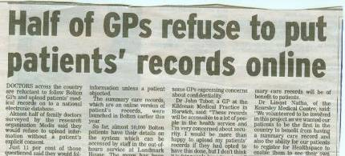
Reasons for failure 23 (of 245)
Doctor, 20 Feb 07
26 June 07
Hospital Doctor, 08 Feb 07
14
Notes:
14

Slide 15
“IT will make an efficient business more efficient ; IT will make an inefficient business more inefficient”
Bill Gates

Slide 16
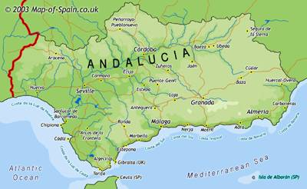

Spain (Andalucia)

Slide 17
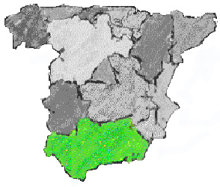
Andalucía
8 million inhabitants
87,579 Km2
17.8 % of Spanish population
91 inhabitants/Km2
Population
Growth: 1.6 %
> 65 years: 14.6 %
Life expectancy
Women: 82.17
Men: 75.24
Birth rate: 11.94 ‰
Standardized mortality rate
Women: 4.83 ‰
Men: 8.70 ‰
Child mortality: 4.74 ‰

Slide 18






Andalusia’s eHealth objective
Integrate the healthcare information of every citizen
A SINGLE
HEALTH
RECORD

Slide 19
Diraya’s key elements
A SINGLE Health record for each citizen
Unified access to all services
All relevant information structured
1
Developed by the practitioners/users
2
3
4

Slide 20



Problems Sheet
Allergic/Contraindications
Personal Background
Current prescription Sheet
Medical Disability Notes
Diagnostics Test
Medical Referrals
Citizen Register
LOCAL RECORD
CENTRAL
RECORD
H.C.
Record Browser
H.C.
H.C.
H.C.
H.C.

Slide 21
Lessons learned in Spain
Involve professionals in the inception of the system in order to create useful tools for the clinical practice.
Feedback of information.
Provide support to management level information systems. Staff involvement.
Political support.
Internal and external communications

Slide 22

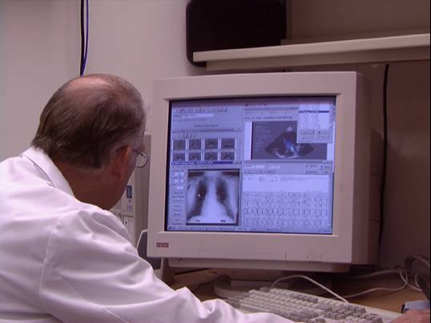
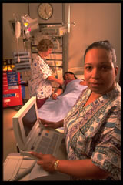
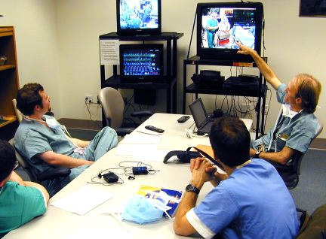
US – Veteran’s Administration
Every VA Medical Center has
Electronic Health Records and
Computerized Order Entry!

Slide 23
Veterans Health Administration
Basic stats
  ~ 1,400 Sites-of-Care
    Including 154 medical centers, ~ 875 clinics,
  198,500 Employees
    > $30 Billion budget
    5.3 million patients

Slide 24
Critical Success Factors at the VA
Top management support
Clinical informatics leadership
Institutional commitment and culture
National networking
Excellent infrastructure and resources
Inpatient/outpatient care can be documented by same system
Notes:
Staff / Space / Equipment / Furniture / Infrastructure / Hardware / Supporting software / Time
Adequacy of infrastructure
Access: 2700 PC Workstations/400 Thin Client Workstations/Mobile wireless workstations/Remote logon/VPN
Response time: Major hardware upgrade
Reliability: Systems team
Corporate culture
Productivity expectations
Transition period – “hybrid system”
Training, training, training
Roll out strategy – “waves”

Slide 25
Sweden

Slide 26
In 1995, the northern region of Norrbotten mandated that everyone – including all PHC centers and hospitals - would use a single common system.
One of the justifications was to eliminate the problems surrounding the electronic transmission of records between sectors and different computer systems.
This approach has become widespread in all Sweden with adoption of standards.

Slide 28

Critical success factors in Sweden
Local autonomy
National EHR standards
Clinical leadership
Advanced IT infrastructure

Slide 29
Patient Summaries transfer
Emergency care summary Scotland
EPSOS Europe

Slide 30

Emergency Care Summary
– a taster of the successes
7.000.000
6.000.000
5.000.000
4.000.000
3.000.000
2.000.000
1.000.000
0
2002
2003
2004
2005
2006
2007
2008
2009
2010
Present value of total annual costs
Present value of annual benefits

Slide 31

EPSOS
Transfer of patient summaries across EU countries
Developed Standards
Legal and Governance Agreements
Technical & Semantic Interoperability
Open Source developments

Slide 32
eHealth in Chile

Slide 33


Slide 34
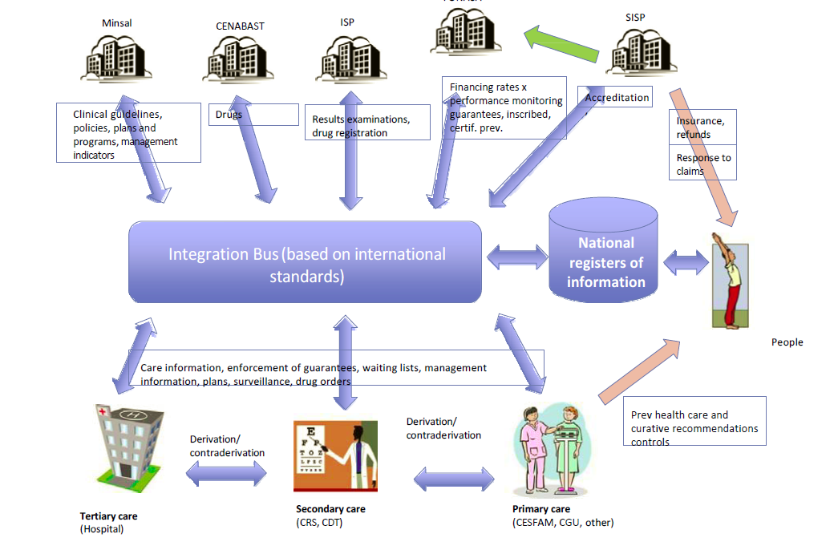

Slide 35
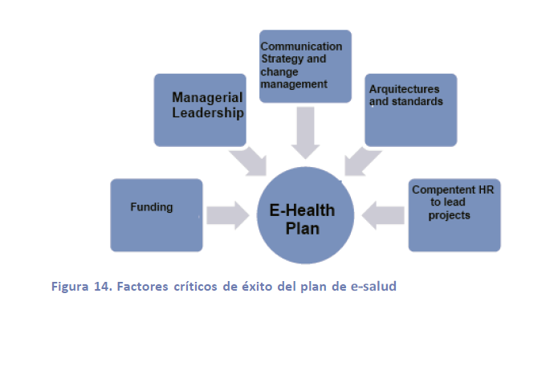

Slide 36
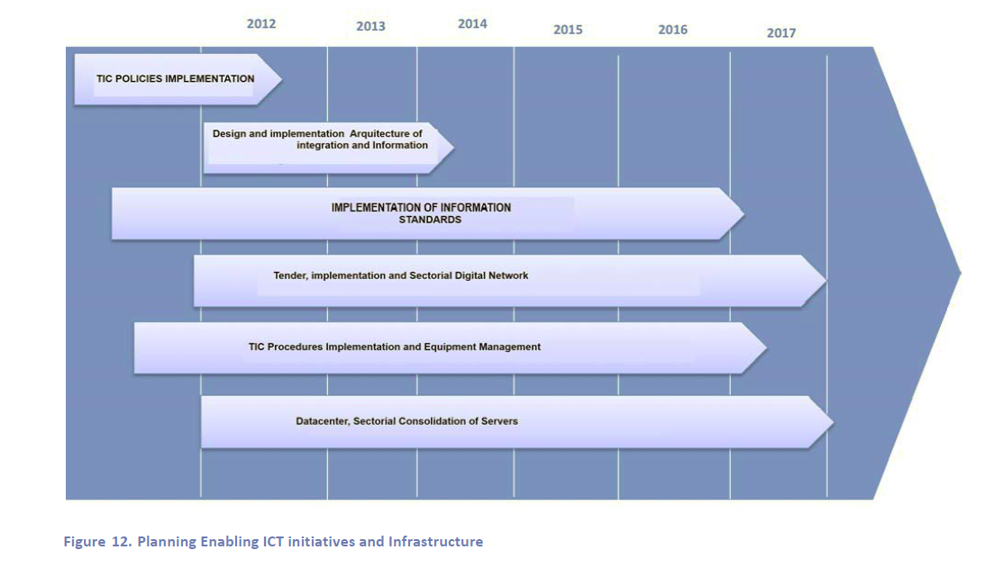

Slide 37
eHealth in Chile ?

Slide 38
eHealth in South Africa ?
You Decide !

