Slide 1

IHE
(Integrating the Health Enterprise)
Bringing Imaging Informatics and Health Informatics together
Clive Daniell
Independent PACS / RIS Consultant
Co founder of MiiTA
Credit: Dr Otto Schulze
Radiologist
Co founder of MiiTA

Slide 2
IHE
Integrating the Healthcare Enterprise
What is IHE?
What it achieves or tries to achieve?
Challenges using IHE in South African environment.

Slide 3
IHE
Integrating the Healthcare Enterprise
This is a consortium of radiologists and information technology experts, formed in 1997.
IHE aims to create a process through which interoperability can be implemented.
It describes how to use standards such as DICOM and HL7 to accomplish certain workflow scenarios within a multi-vendor environment.
If you can regard DICOM and HL7 as dictionaries for a specific language, then IHE is a textbook of commonly used phrases.

Slide 4
IHE - Definitions
IHE Integration Profiles
  Describe a clinical information need or workflow scenario and documents how to use established standards (e.g. HL7, DICOM, LOINC...) to accomplish it.
  Integration Profiles are an effective shorthand for healthcare providers to specify integration requirements when purchasing systems.
IHE Integration Statements
  Are simple documents prepared and published by a vendor to list the IHE Profiles supported by a specific release of a specific product.
IHE Technical Frameworks
  Are the detailed documents which specify the Integration Profiles and the associated actors (systems) and transactions.
IHE Connectathons
  Are annual events where equipment vendors bring products with IHE Profiles and test them with other vendors.

Slide 5
IHE - Definitions
Actor
  A system or application responsible for certain information or tasks—e.g., the Order Placer Actor. Each Actor supports a specific set of IHE transactions to communicate with other Actors. A vendor product may include one or more Actors.
Transaction
  An exchange of information between Actors. For each Transaction, the technical frame work describes how to use an established standard (such as HL7, DICOM or W3C) to exchange information.
Domain
  A working group in IHE that addresses a particular clinical area—e.g., Radiology, Cardiology, Laboratory or IT Infrastructure. Each domain publishes a Technical Framework (TF).

Slide 6
IHE – What does it achieve?
IHE Profile - Radiology
Workflow
Content
Presentation
Infrastructure
Actors
Transaction
Technical Framework

Slide 7
IHE – Profiles (Radiology)
Workflow scenarios
Scheduled Workflow (SWF)
Patient Information Reconciliation (PIR)
Post-Processing Workflow (PWF)
Reporting Workflow (RWF)
Import Reconciliation Workflow (IRWF)
Portable Data for Imaging (PDI)
Nuclear Medicine Image (NM)
Mammography Image (MAMMO)
Evidence Documents (ED)
Simple Image and Numeric Report (SINR)
Key Image Note (KIN)
Consistent Presentation of Images (CPI)
Presentation of Grouped Procedures (PGP)
Image Fusion (FUS)
Cross-enterprise Document Sharing for Imaging (XDS-I)
Teaching File and Clinical Trial Export (TCE)
Access to Radiology Information (ARI)
Audit Trail and Node Authentication (ATNA)
Charge Posting (CHG)

Slide 8
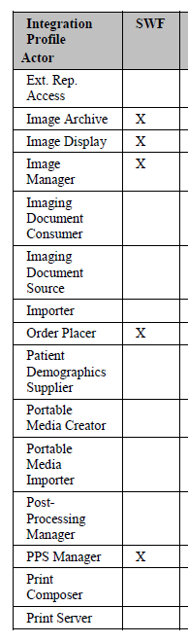
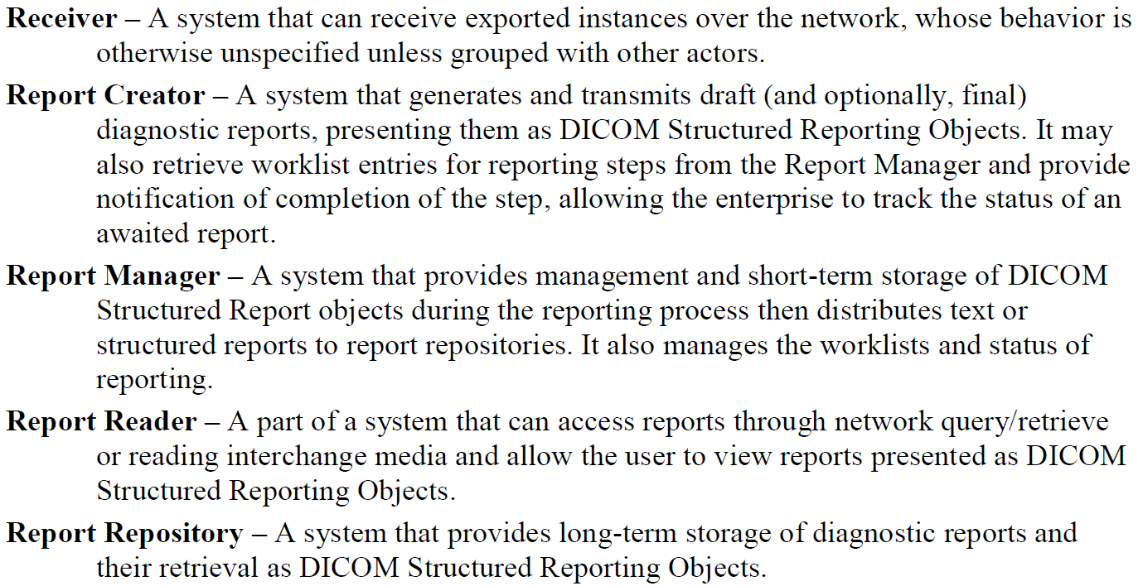
IHE - Actors

Slide 9
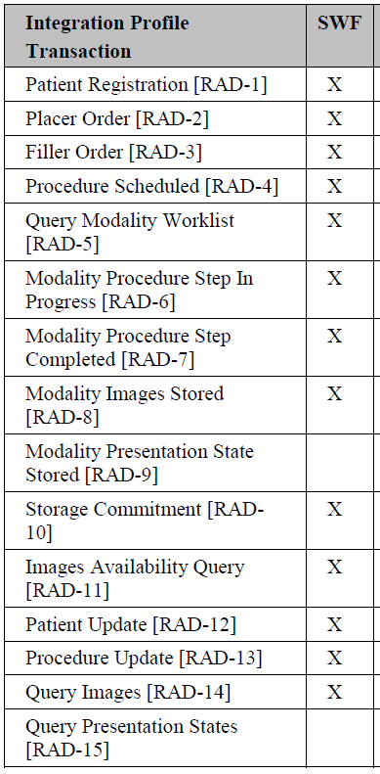
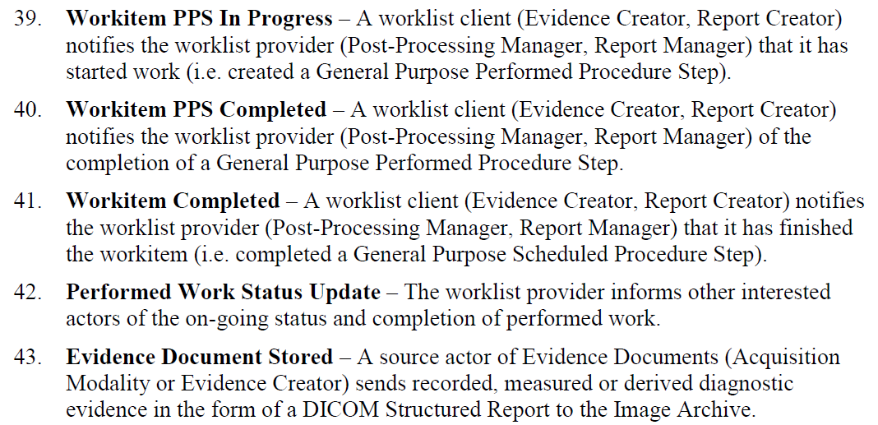
IHE - Transactions

Slide 10
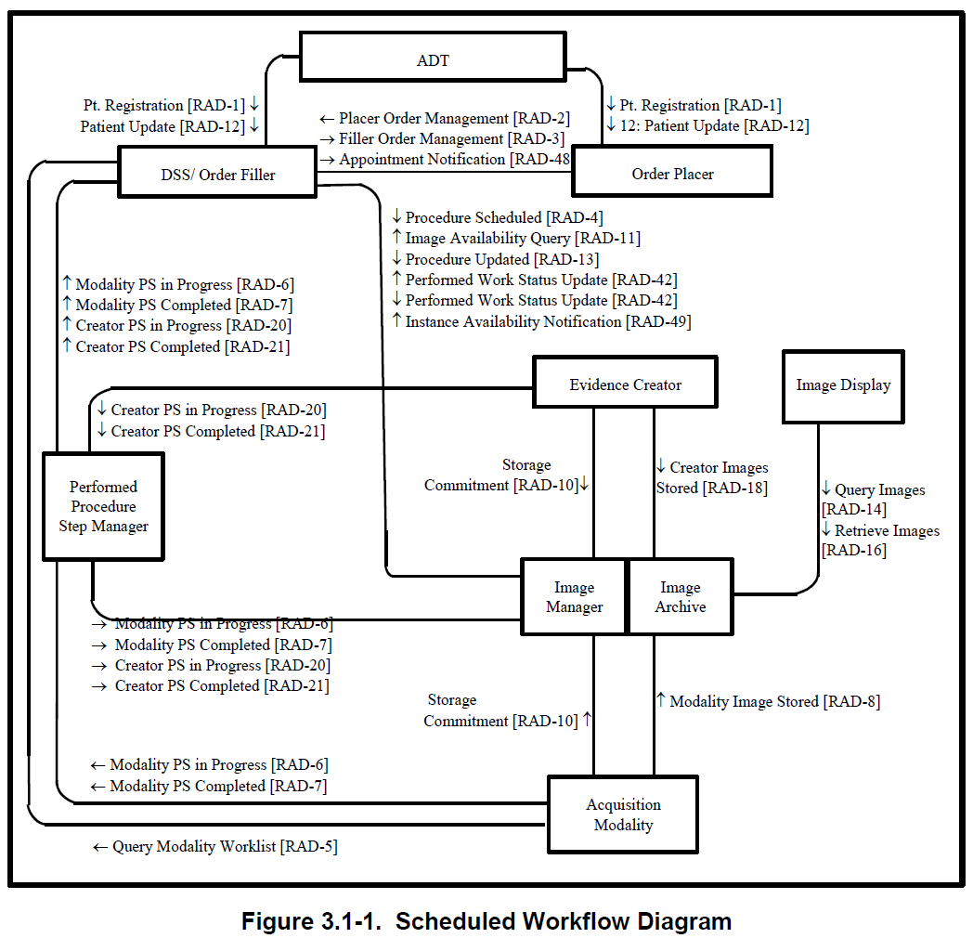
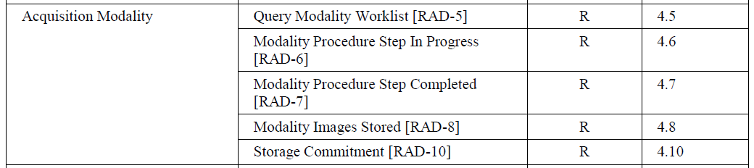

Slide 11
IHE Technical Frameworks

Slide 12
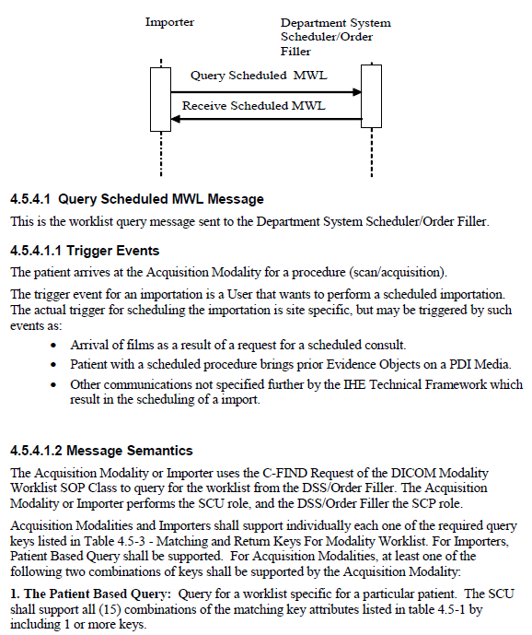
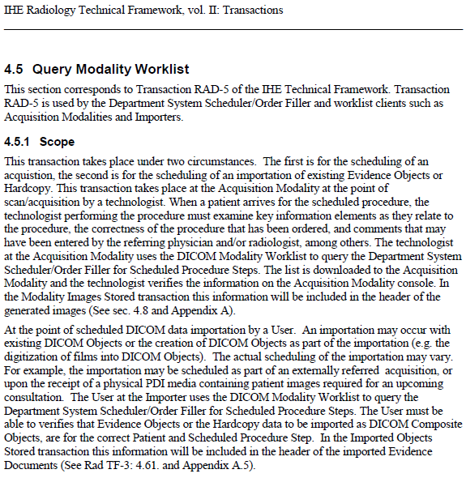
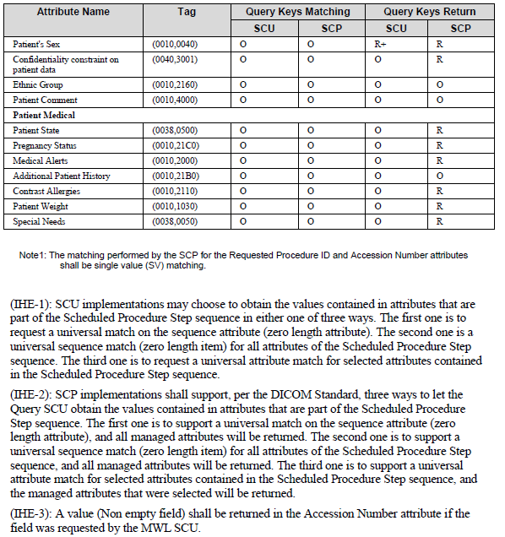
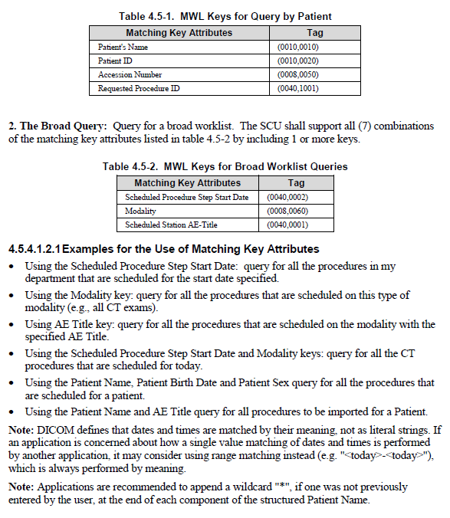
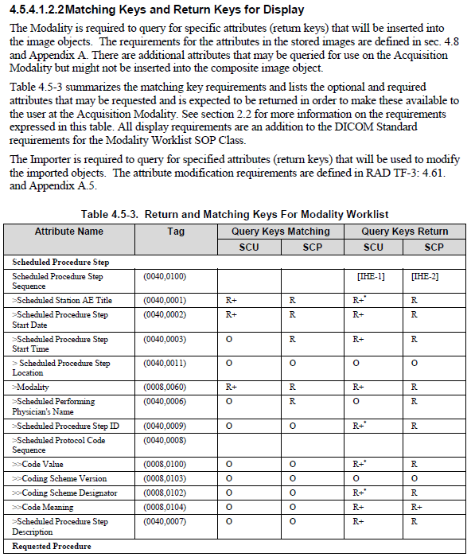
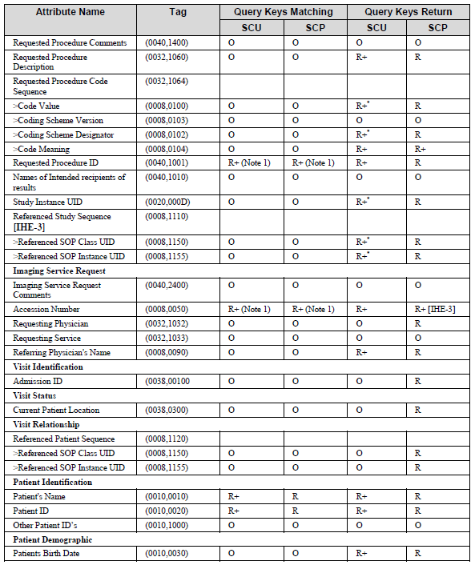
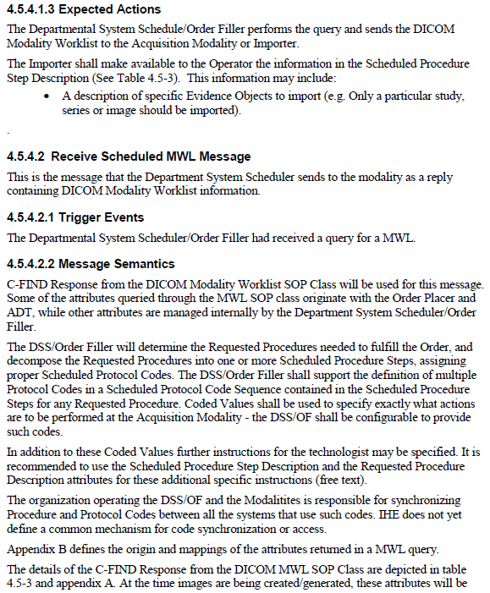
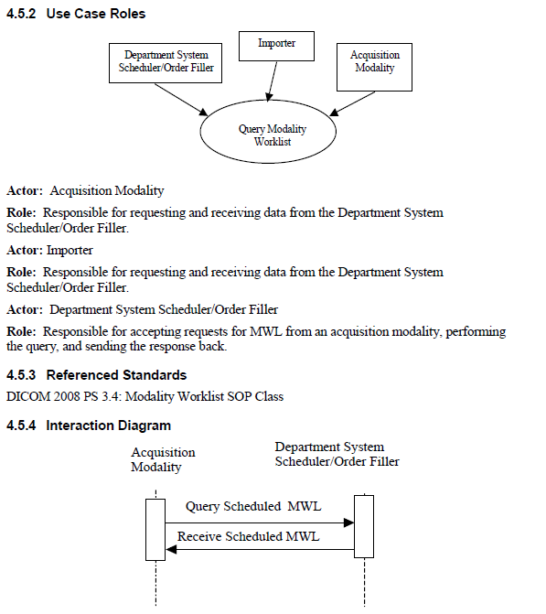

Slide 13
IHE Integration Statements

Slide 14
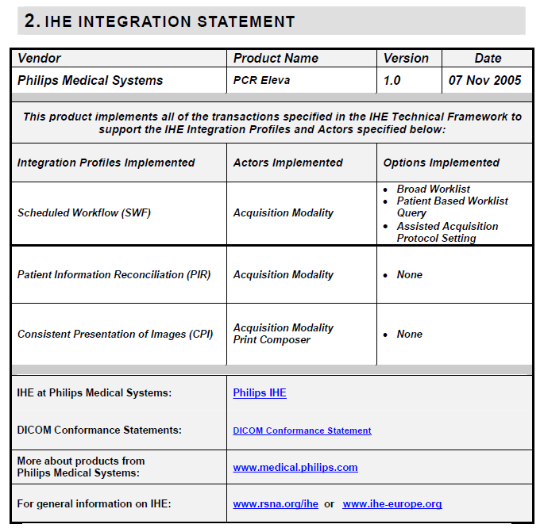
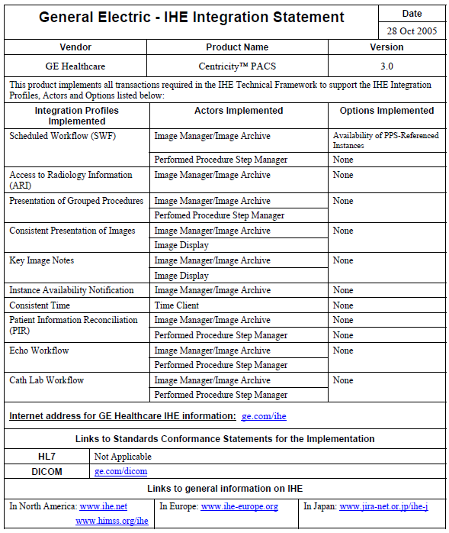

Slide 15
Challenges using IHE in the South African Environment.
You have to understand what you want.
Lack of knowledge of how IHE should be used.
It has to be defined as a requirement upfront.
Lack of understanding of the standards.
Lack of ownership of the solutions.

Slide 16
IHE
(Integrating the Health Enterprise)
Bringing Imaging Informatics and Health Informatics together
Clive Daniell
Independent PACS / RIS Consultant
Co founder of MiiTA
Thank You

