Slide 1
Does SA have the skills and ability to write and deliver meaningful online learning material?
Prof. Johan van Niekerk

Slide 2
Something to Think about
The blackboard, or “chalkboard” was first introduced into American schools in 1801…
Can teachers today really reach the current generation of “digital natives” if they only use technology that is more than 200 years old?

Slide 3
Learning Characteristics of Gen Y
General
  Short concentration span
  Desire individual recognition
  View own opinion is important
  View the destination as more important than journey
  Passive
  Desire immediate impact with little effort
  Gather trophies and accolades
  Use social technology constantly
Learning Related
  Desire a challenge
  Want to build skills quickly
  Prefer small goals with tight deadlines
  Share information readily and use each other as a source of information
  Prefer limits and structure, and need clear guidance
  Choose breadth rather than depth in researching new topics
  Only retain information deemed relevant
  Information needed is gathered just in time
Payne, S.L. & Holmes, B., 1998, Communication challenges for management faculty involving younger Generation, Journal of Management Education; June Vol. 22, No. 3; ABI/INFORM Global, pg. 344-367

Slide 4
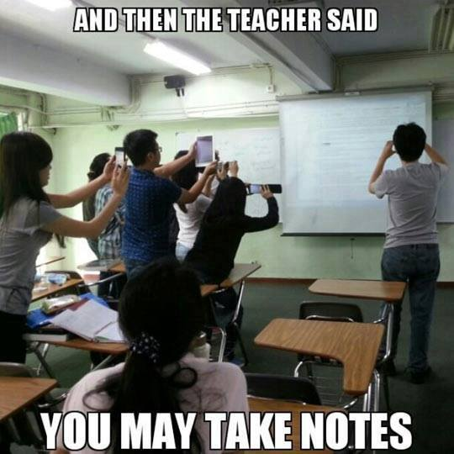
Today’s students WANT to use technology

Slide 6
The BIG question
Is e-learning WORTH all the effort?

Slide 7
E-learning-Is it worth it?
Evaluation of Evidence-Based Practices in Online Learning: A Meta-Analysis and Review of Online Learning Studies – US Department of Education 2009
  The meta-analysis of 51 study effects, 44 of which were drawn from research with older learners, found that:
    Students who took all or part of their class online performed better, on average, than those taking the same course through traditional face-to-face instruction.
    Instruction combining online and face-to-face elements had a larger advantage relative to purely face-to-face instruction than did purely online instruction
    Studies in which learners in the online condition spent more time on task than students in the face-to-face condition found a greater benefit for online learning.

Slide 8
E-learning-Is it worth it?
    Most of the variations in the way in which different studies implemented online learning did not affect student learning outcomes significantly.
    The effectiveness of online learning approaches appears quite broad across different content and learner types.
    Effect sizes were larger for studies in which the online and face-to-face conditions varied in terms of curriculum materials and aspects of instructional approach in addition to the medium of instruction.
    Blended and purely online learning conditions implemented within a single study generally result in similar student learning outcomes.
    Elements such as video or online quizzes do not appear to influence the amount that students learn in online classes.

Slide 9
E-learning-Is it worth it?
    Online learning can be enhanced by giving learners control of their interactions with media and prompting learner reflection.
    Providing guidance for learning for groups of students appears less successful than does using such mechanisms with individual learners.

Slide 10
E-learning – Is it worth it? Summary
In recent experimental and quasi-experimental studies contrasting blends of online and face-to-face instruction with conventional face-to-face classes, blended instruction has been more effective, providing a rationale for the effort required to design and implement blended approaches.
Even when used by itself, online learning appears to offer a modest advantage over conventional classroom instruction.

Slide 11
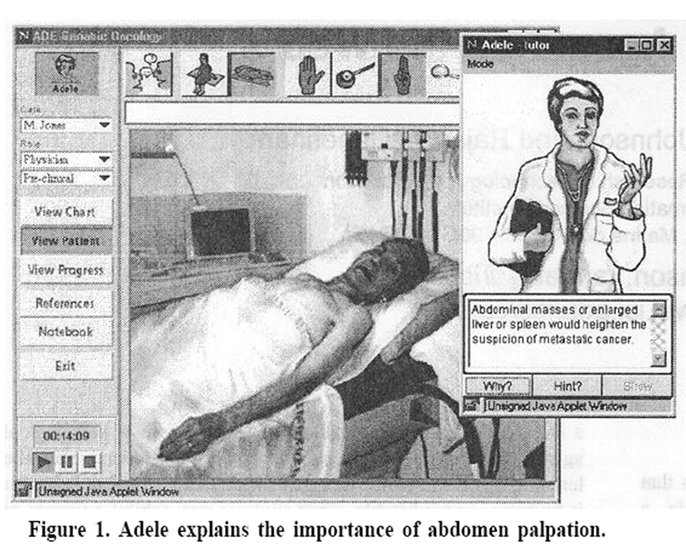
E-Learning in Health

Slide 12
Is South Africa ready for E-learning?

Slide 13
Are South African learners ready?

Slide 14
Case study: HE Students
A research project on access and use started in 2004
  mixed-method approach
  twelve universities in South Africa
Comprising
  two surveys of 10 110 students (2004 and 2007)
  quantitative analysis of 58 question survey
  qualitative analysis of the questionnaire’s open-ended questions
  student interviews (2009) – preliminary findings
  Survey of OLE at UCT (2008)

Slide 15
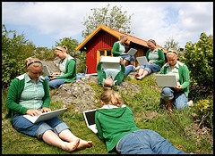
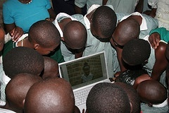
The digital divide
On-campus, access is fair and equivalent
Off-campus access is varied and unequal

Slide 16
HE digital divide worsening
Digital divide exacerbated
  Small (11%) but distinct group of South African students display characteristics of “digital natives” in that they have:
    grown up with computers;
    are independent when solving computer problems and learning new skills, and
    draw extensively on their social networks.
  But a significant group of student (22%) still lack both experience and opportunities, as they have:
    been using a computer for less than 4 years; and
    have no direct access to ICTs off campus.

Slide 17
Are South African teachers ready?

Slide 18
E-Learning
Simply making "normal" textbooks, slides, or lecture notes available online is not necessarily good pedagogy!
Posting unedited video of your lectures is almost worse!

Slide 19
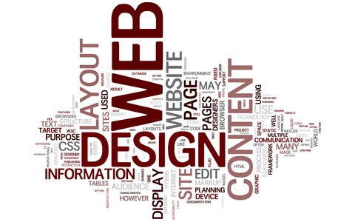
We need to leverage technology!
Color
Sound
Media
Interaction
Design

Slide 20
Principles for good e-learning material
1. A learning experience should be as multifaceted as possible; catering for as many learning styles as possible and providing as many opportunities for each learner to develop as possible.
2. Positive emotions should be used to aid recognition and recall
3. Relate all new material back to old material and thereby build new knowledge on old knowledge
4. The search for meaning is innate and occurs through patterning.

Slide 21
Principles for good e-learning material
5. Every brain simultaneously perceives and creates parts and wholes during the learning process.
6. It is necessary to repetitively review material to solidify recall and recognition.
7. Both focused and peripheral attention of a learner should be involved in the learning process.
8. Allow learners to progress through the course at their own pace.

Slide 22
To create good e-learning material
A lecturer needs to be:
  A subject specialist
    content
  An educational expert
    pedagogical principles
  A graphic designer
    Look & Feel
  IT Expert
    Most tools out there are NOT easy to use

Slide 23
Do we have the infrastructure?

Slide 24
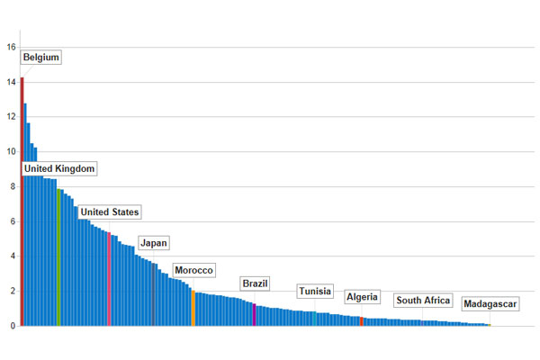
Bandwidth Quality
Source: Measurement Lab Research Consortium (2013)

Slide 25
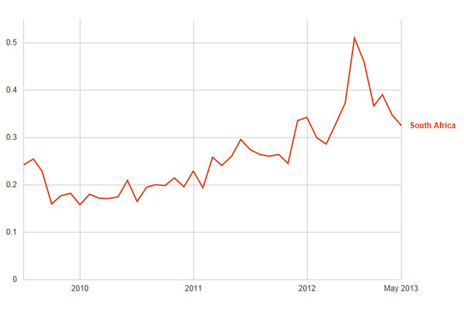
Download Speeds
Source: Measurement Lab Research Consortium (2013)

Slide 26
Conclusion? (My Opinion)
Our learners are somewhat ready…
Our teachers are not ready…
Our infrastructure is still very lacking…
?

