Slide 1

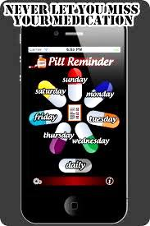
Designing a Mobile Pill Reminder for Elderly Users in South Africa
Mr Cainos Mukandatsama
Professor Janet Wesson
Department of Computing Sciences

Slide 2


Background
Elderly people are prone to chronic diseases
Intake of many pills everyday:
  Correct pills and the right dosage
  At prescribed times
Effects of not adhering can be serious
Identification of pills can be problematic
Responsibility on caregivers and family
Pills must not run out unexpectedly

Slide 3

Relevance
Elderly people requires reminders:
  Audio based
  Text and Graphic based
Minimum attention on pill takers
Mobile phones are widely used in SA
Running out of pills is not an option
Lack of caregivers
Need for monitoring mechanism

Slide 4
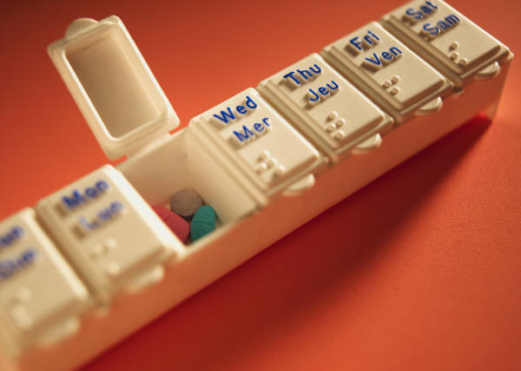
Existing Systems
MedTracker- 7-day drug store pillbox
  Connected to a computer (not portable)
  Connection is via Bluetooth
Real Time Medication Monitoring
  Electronic dispenser and SMS reminder
  No assistance in identifying pills
  Users were keen adopt the technology
Wedjat -mobile solution
  Runs on Android platform
  No action if there is a violation
  No visual cues

Slide 5
Functional Requirements
Patients:
  Remind the patient to take pills at the prescribed times
  Link the patient with caregivers and pharmacies
  Provide audio reminders
  Give visual cues to help in identifying the pills
  Automatically re-order pills 48 hours prior to their depletion
Caregivers:
  Use a database to load the prescription
  Notify the caregivers of a violation
  Add pharmacies and their preferences
  Provide a history of how pills were taken

Slide 6
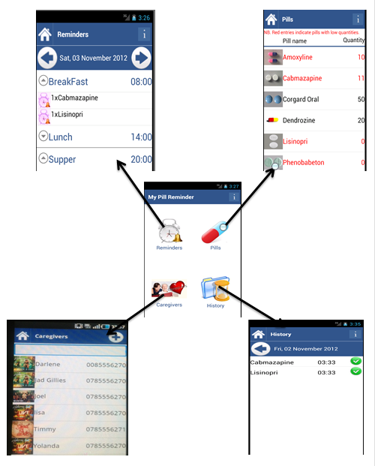

Slide 7
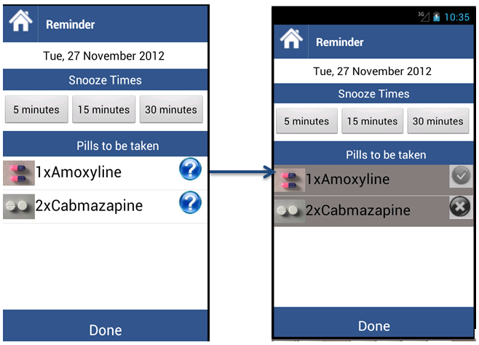
Reminder

Slide 8
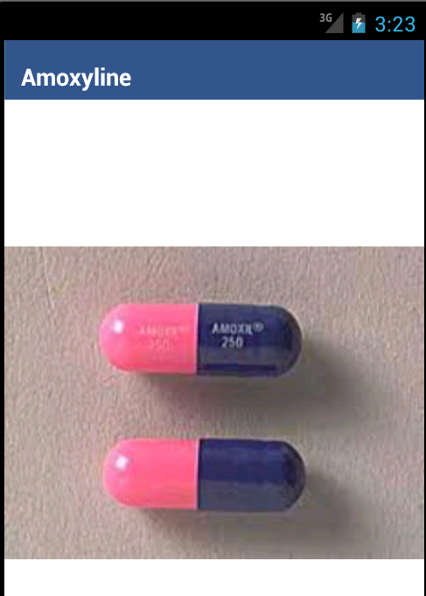
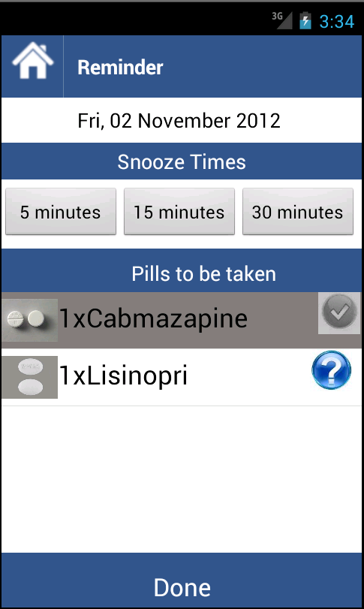
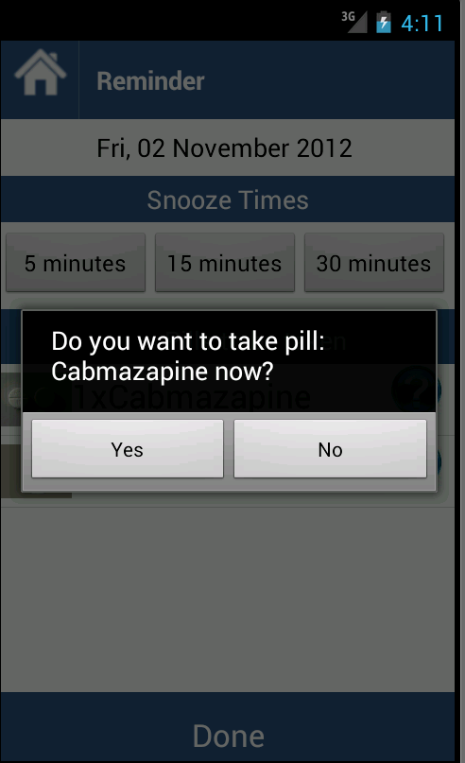
Taking Pills

Slide 9
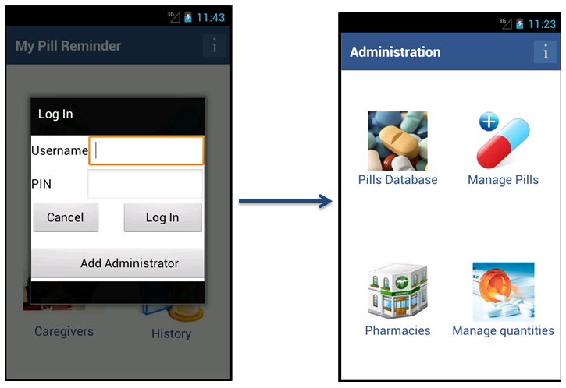

Slide 10
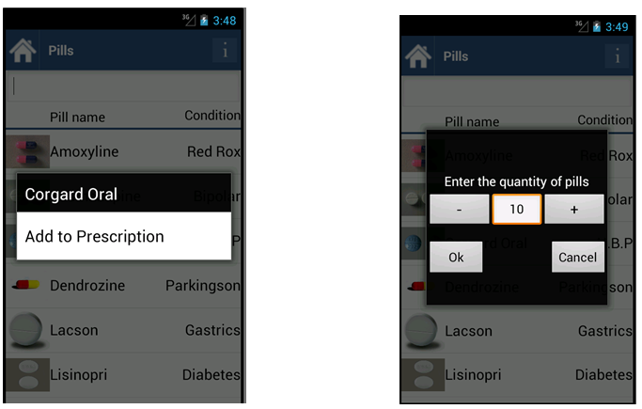
Adding Pills

Slide 11
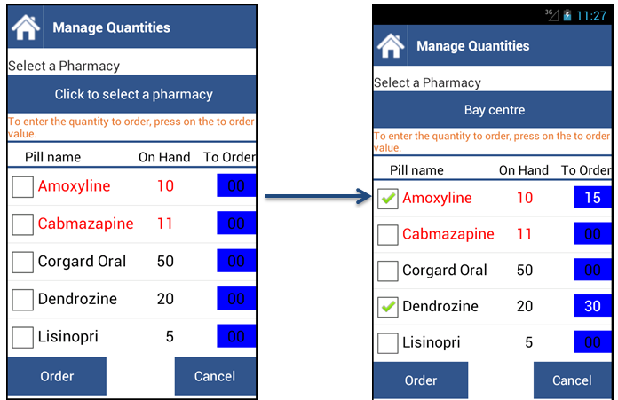
Reordering

Slide 12
Evaluation
Informal testing:
  Done by peers and during weekly meeting
Expert reviews:
  Cognitive Walkthrough and Heuristic Evaluation
User study:
  Actual users evaluating the app
Investigated the usability of the app:
  User experience
  Identified usability issues

Slide 13
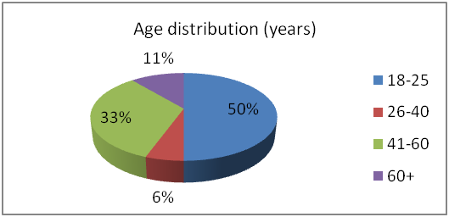
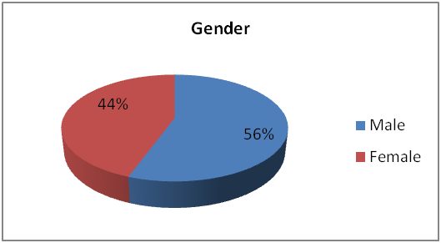
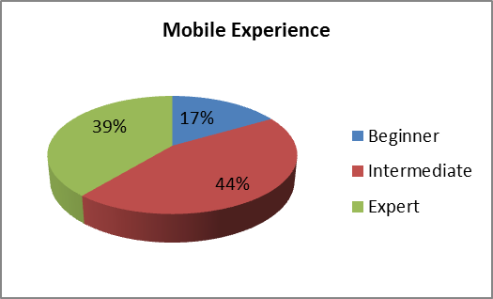
Participants (n=18)

Slide 14
Metrics
Number of errors made by the user during the use of the application
Time taken to complete certain tasks Number of incorrect options selected and other user errors
Number of questions asked requesting help
Whether or not a task was completed correctly.

Slide 15
Method
Samsung Galaxy S 3G mobile phone
Small demo done at the beginning
Video-recording the participant-device interactions
Think-Aloud Evaluation protocol used
Time on task: stopwatches and videos used
Correct completion: questions used
Participants allowed to ask questions
PSSUQ questionnaire used:
  Get both UX & usability (issues) feedback

Slide 16
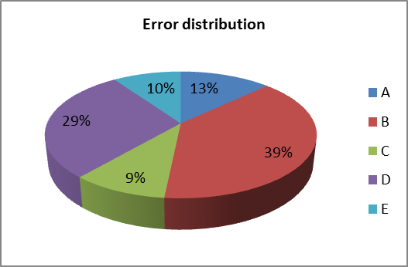
Errors
Type | Actual meaning
A | Pressing back button more than once
B | Typing errors
C | Pressing the wrong home button whilst on the administration screens
D | Clicking instead of having a long press
E | Forgetting to save

Slide 17
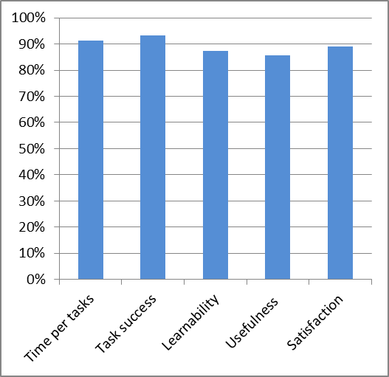
Overall usability

Slide 18
Recommended changes
Usability issues:
  Several errors or difficulties in execution.
Suggested changes:
  More searching options
  Search box always there
  Detailed error messages
  Label should be visible

Slide 19
Design Implications
Functionality | Principle | Guideline
Text display | Accessibility, Visibility | Use large fonts, with visual cues and good color contrast.
Text entry | Error prevention, Flexibility | Use alternative text input methods, including options and lists.
Navigation | Consistency, Predictability | Use a simple navigation scheme, with minimal levels and clear icons. Include a Home icon.
Feedback | Visibility | Provide feedback on options selected and data entered.
Reminders | Ease of use | Provide audio and visual reminders.
Notification | Error prevention | Notify caregivers when patient fails to take medication.
Reordering medication | Ease of use Error prevention | Automate re-ordering of medication before it is needed.
History | Visibility | Provide a history of medication compliance for the patient.

Slide 20
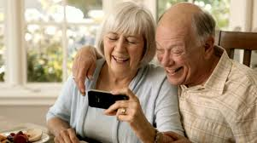
Conclusions
Possible benefits of project:
  Monitoring mechanism for pill intake
  No such application for elderly users in SA
  Easy to learn application
Future work:
  Client and server system
  Conduct field studies
  Expand to other platforms

Slide 21

Q & A

Slide 22
Thank you

