Slide 1
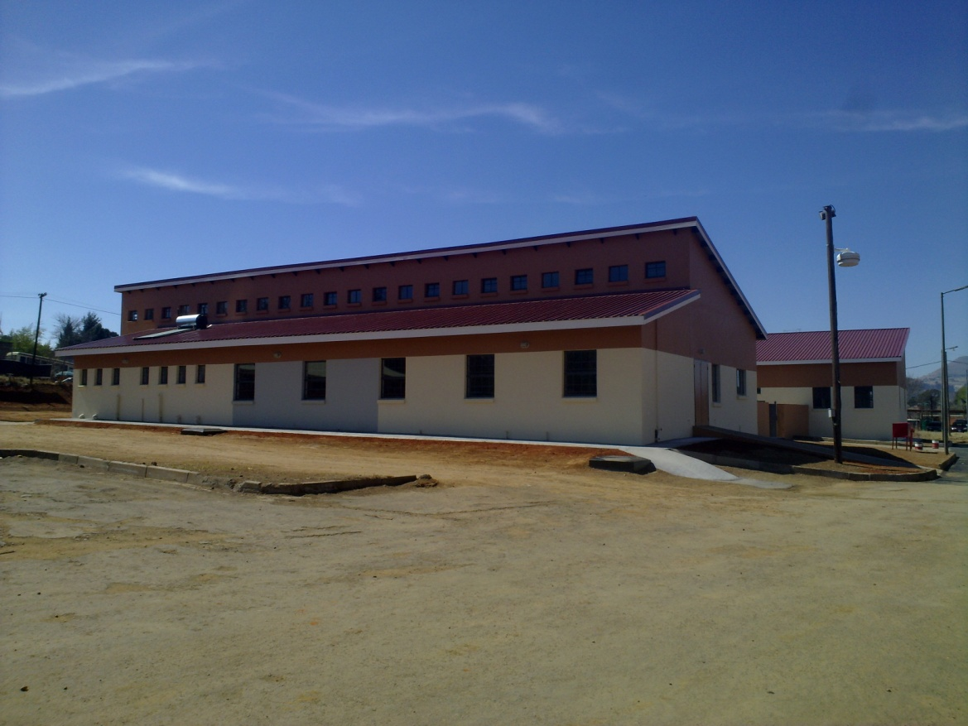
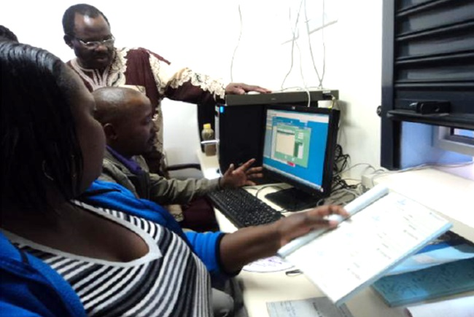
Lessons learned from implementing a full-package Electronic Medical Record System in Lesotho Outpatient Departments to improve Patient Waiting Time and Quality of Care
– a potential Success Story for the Country
Stiaan Byleveld

Slide 2
Overview
Funder: The Millennium Challenge Account (MCA) in Lesotho with funding from the Millennium Challenge Corporation (MCC) of the US Government
Duration: October 2009 – May 2013
Partners: Health Systems Trust (HST), National Institute of Health and Welfare (THL) of Finland and In-Develop of Sweden
Setting: Lesotho

Slide 3
Process
Phase 1: Review current systems
Phase 2: Develop design and plan
Phase 3.1: Customize & pilot to “determine what level of electronic medical records is appropriate”
Phase 3.2: Critical assessment of EMR pilot to inform the decision by the Ministry on the level of EMR to be rolled out
Phase 4: Roll out to be informed by the MOH’s decision on appropriate system to implement

Slide 4
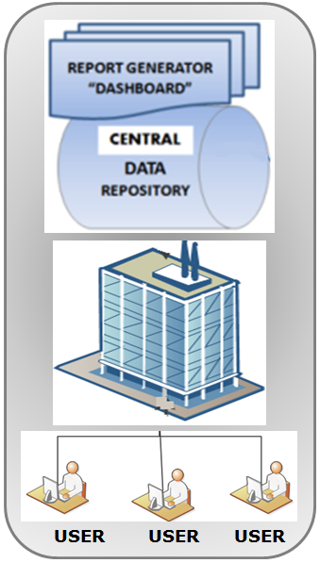
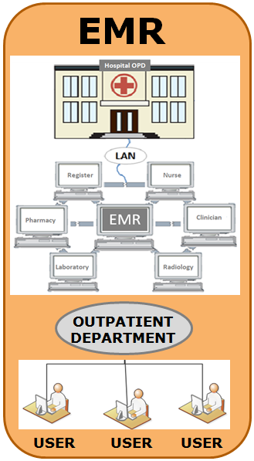
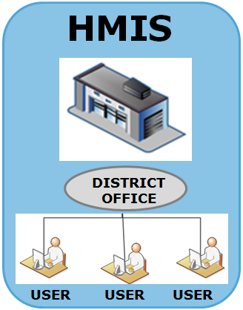
ICT Architecture
DISTRICT
CENTRAL

Slide 5
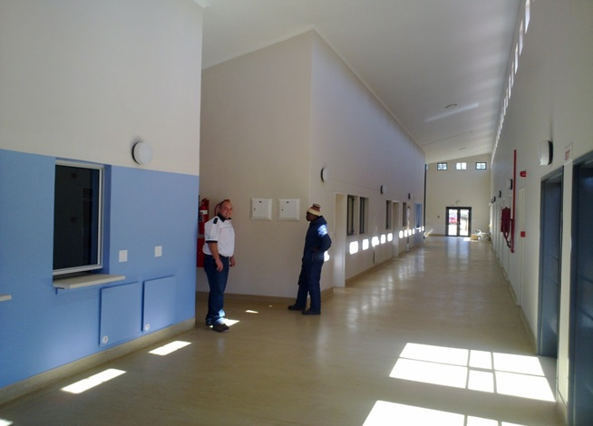
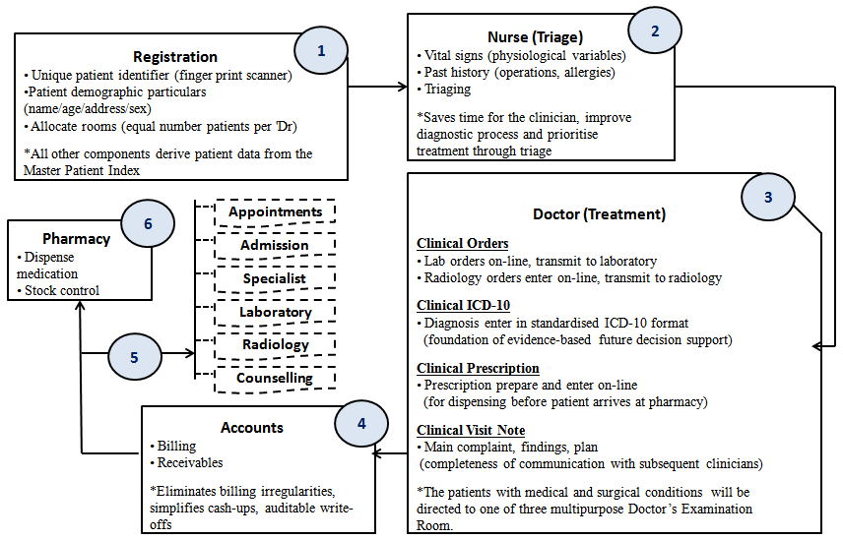
EMR Flow

Slide 6
Improvements
Improvement in quality of care through;
Integration of Standard Treatment Guidelines into the EMR system
Availability of the patient’s full clinical history in the EMR system
Improvement of patient flow through;
Managing daily patient load per clinician through integration of services in the OPD
Nurses capturing past history and vital signs at the nursing station in order to reduce the workload of doctors
Unique patient identifier that allows tracking of patients between hospitals, and potentially between health centres and hospitals
Enhanced patient identification and security through the use of bio-metrics.
Remote support possible through central ICT infrastructure

Slide 7
Lessons learned
The use of the EMR clinical module by doctors is crucial;
Doctor’s role should be emphasized
New doctors undergo orientation before being deployed to OPD
Nurses can reduce workload of doctors and improve quality of care;
By taking care of patients with minor diseases
Capturing information in the EMR system (Vitals, History)
Orientation of doctors on ICD-10 coding is essential before Go-Live
EMR should not be used to enforce integration of services at an OPD
Nerve Centre for appreciation of EMR system at central level

Slide 8
Conclusion
The presentation has shown;
Potential improvement of quality of care and a reduction in patient waiting times through the implementation of a low cost point-of-care EMR system in Lesotho OPDs.
Lessons learned from the Lesotho experience can potentially inform the decision on the level of EMR system appropriate to roll out to OPDs in other countries.
It proposes a stage-wise implementation, beginning at a pilot site, and replicate with adjustments from lessons learned, to remaining sites.

Slide 9
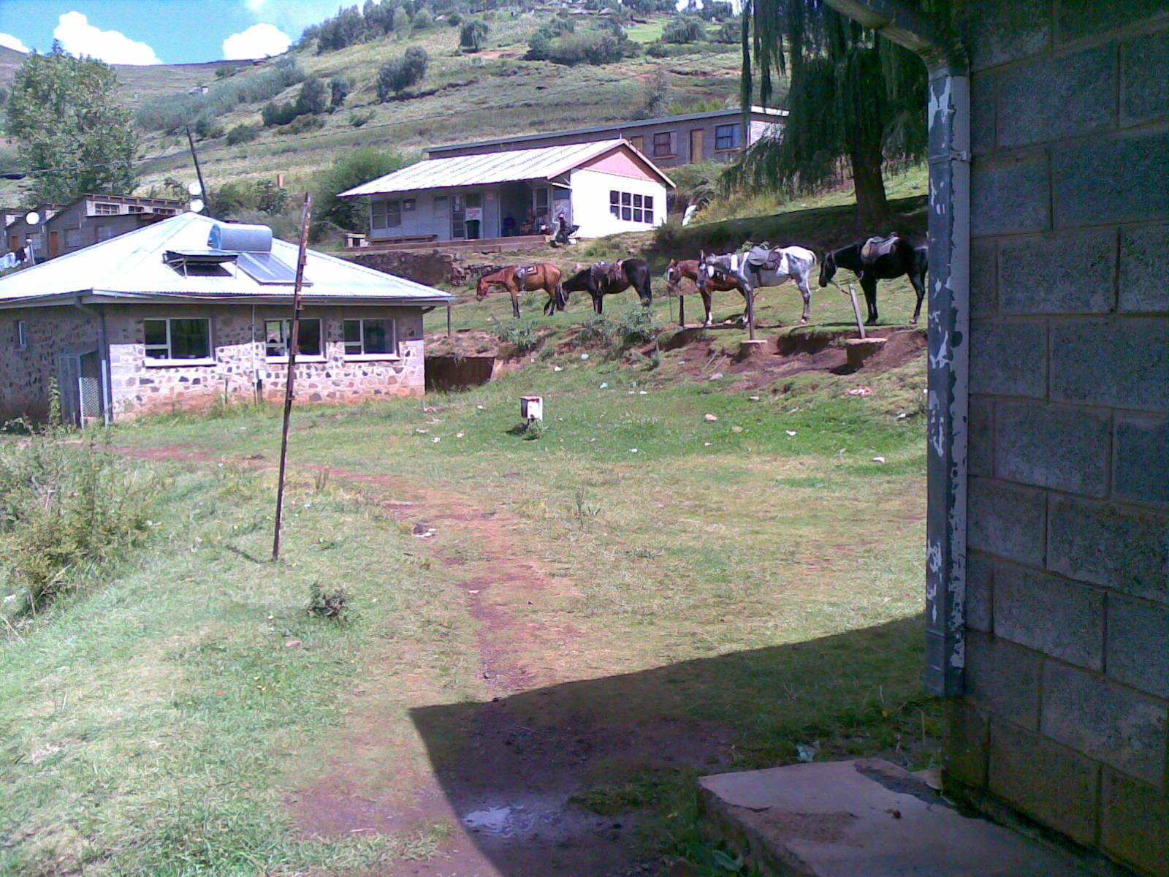
Thank You

