Slide 1
Patient preferences regarding storage media for medical records
Author: Melissa Masiza
Co-authors: Dr Nicky Mostert-Phipps and
Prof. Dalenca Pottas
Funded by: National Research Foundation

Slide 2
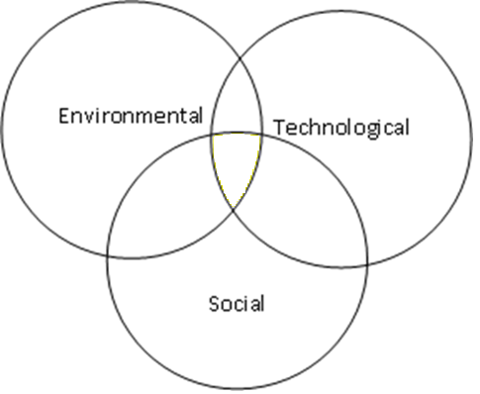
Socio-technical Systems Theory (STS)
Patient and Regulations
EMR
GP, Nurse and Admin staff

Slide 3


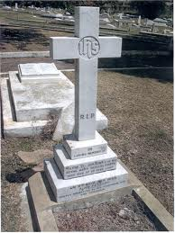

“From the cradle to the grave”

Slide 4
Continuity of Care Hierarchy
Interpersonal Continuity
Longitudinal Continuity
Informational Continuity

Slide 5
Continuity of Care Hierarchy
Interpersonal Continuity
Longitudinal Continuity
Informational Continuity

Slide 6


Patients’ preferred storage media for medical records?
Paper-based medical record? Electronic medical record?

Slide 7
Patients’ preferred storage media for medical records?
“Everyone has the right to participate in decision-making on matters affecting one’s health” - South African Patient Rights Charter

Slide 8

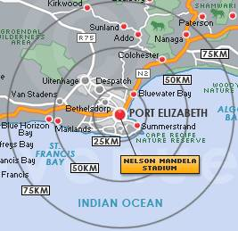

Study participants
85 of 140
patient questionnaires

Slide 9
Demographics
Age distribution
Language distribution
Years visiting this practice
Education profile

Slide 10
    Findings: Continuity & Quality of care
Patients visiting one GP
Perception of negative impact on the quality of care (Paper-based system)

Slide 11
Findings: Patient Confidentiality
Perception of lack of information confidentiality (paper-based system)
Perception of lack of information confidentiality (EMRs)

Slide 12
Findings: Patient Storage Preferences
Prefer that GP should use a computerised system

Slide 13
Findings: Patient Storage Preferences
Prefer that GP should use a computerised system
Overall storage medium preference

Slide 14
Findings: Why?
Categories of key phrase representing concept identified
  Clinical;
  Ecological;
  Security; and
  Technical.

Slide 15
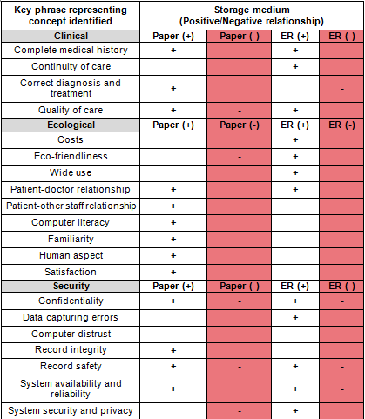

Slide 16
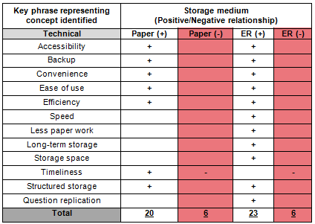

Slide 17
Conclusion
This study found that about half of the participants preferred an EMR. The reasons for their preference were also uncovered.

Slide 18
Acknowledgements
The financial assistance of National Research Foundation towards this research is hereby acknowledged. Opinions expressed and conclusions arrived at, are those of the author and are not necessarily to be attributed to the National Research Foundation.

